Slide 1

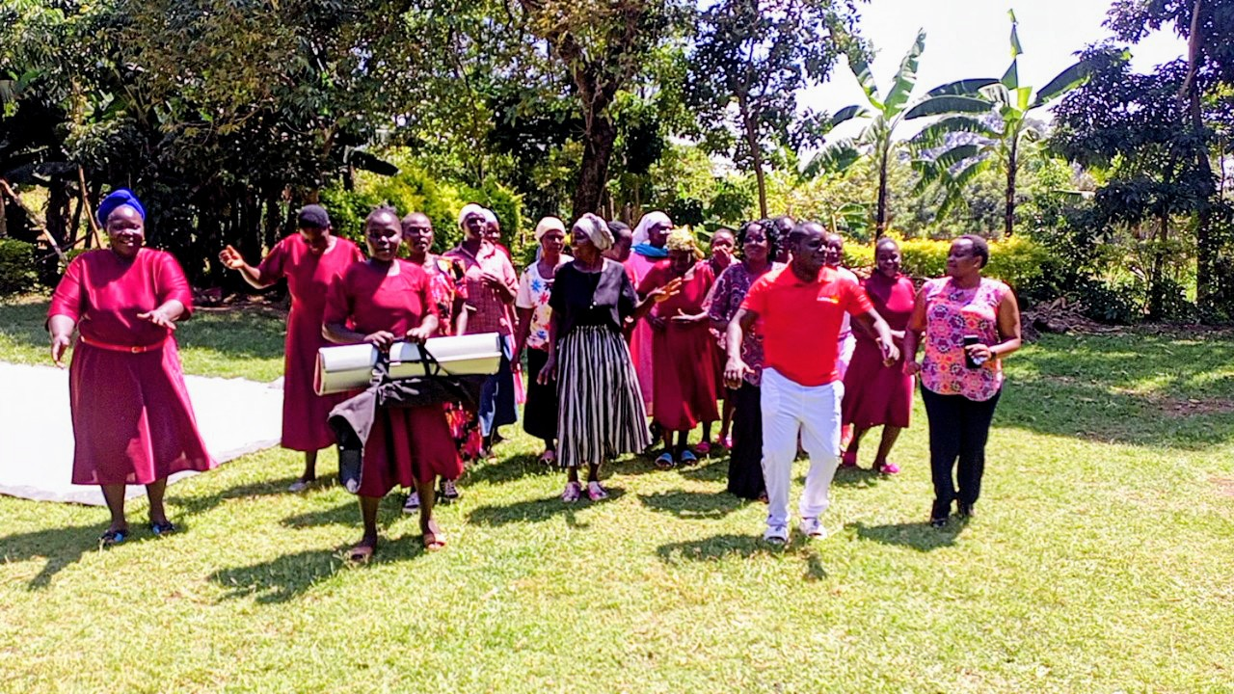
150 SPARKS OF CHANGE
Presented to The Sunset Rotary Club of Bloomington - Normal
March 2025

Slide 2
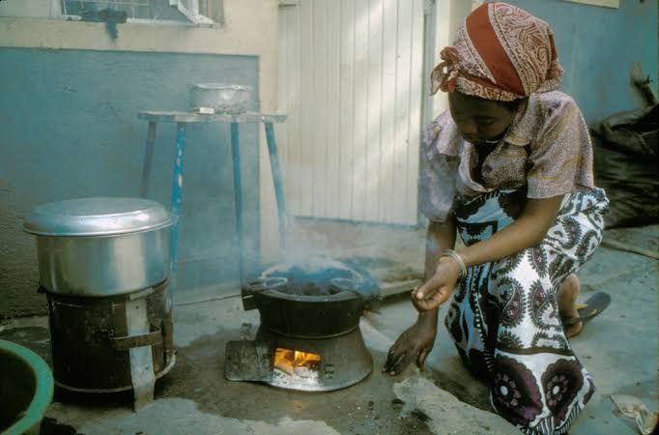
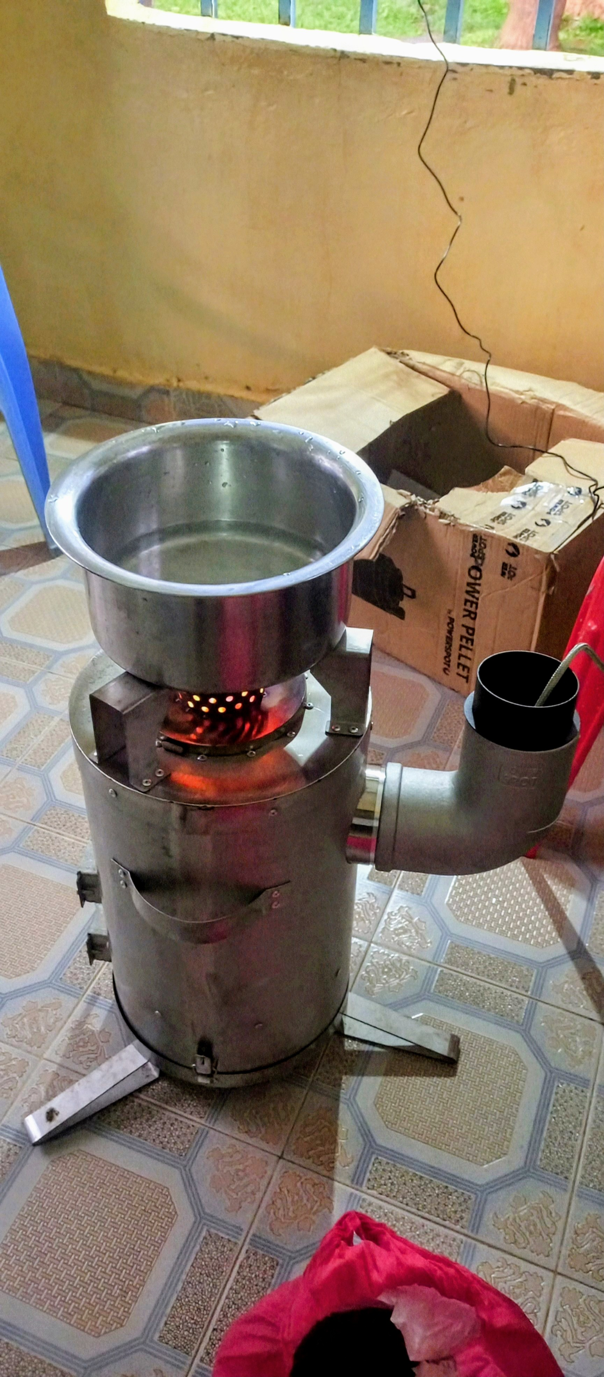
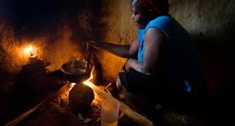
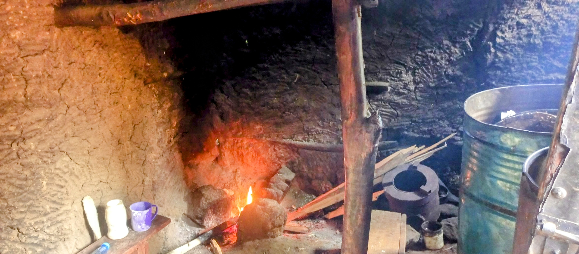
Background & Context
Location: Bungoma County, Kenya
Average Household Size: 5 persons
Average land size: 2 acres per household.
Primary Cooking Fuels:
78.3 Firewood
11% Charcoal
7.2% LPG
2.6% Paraffin
0.4%Electricity
0.4% Biogas
Lighting Sources
Solar energy 21.6%
Paraffin 18.5%
Tin lamps 11.4%
Solar charged torches/lamps 8.2%
Candles 0.9%
Challenges Identified.
Health risks from smoke inhalation
Time lost gathering firewood
Limited access to electricity
Environmental degradation due to deforestation

Slide 3
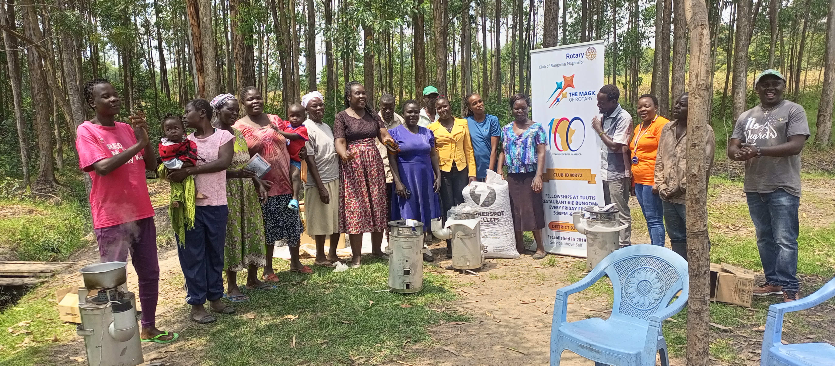
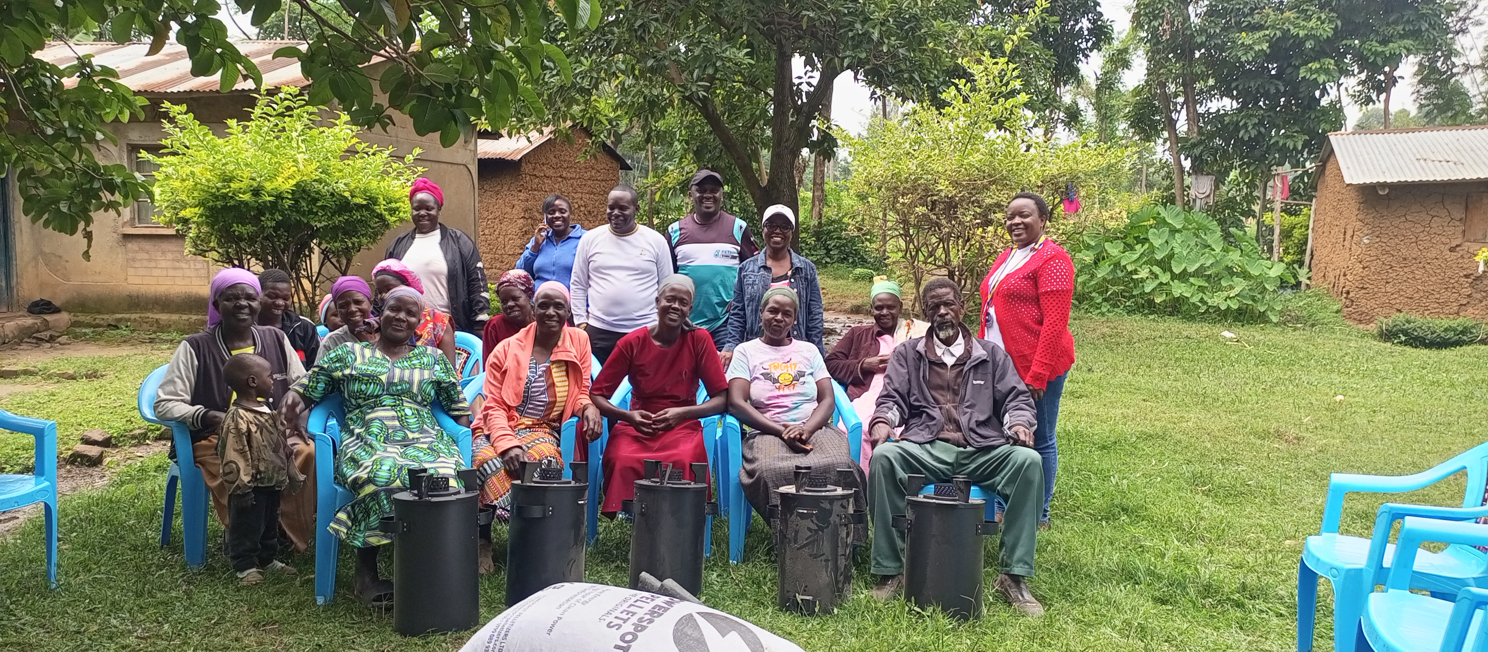
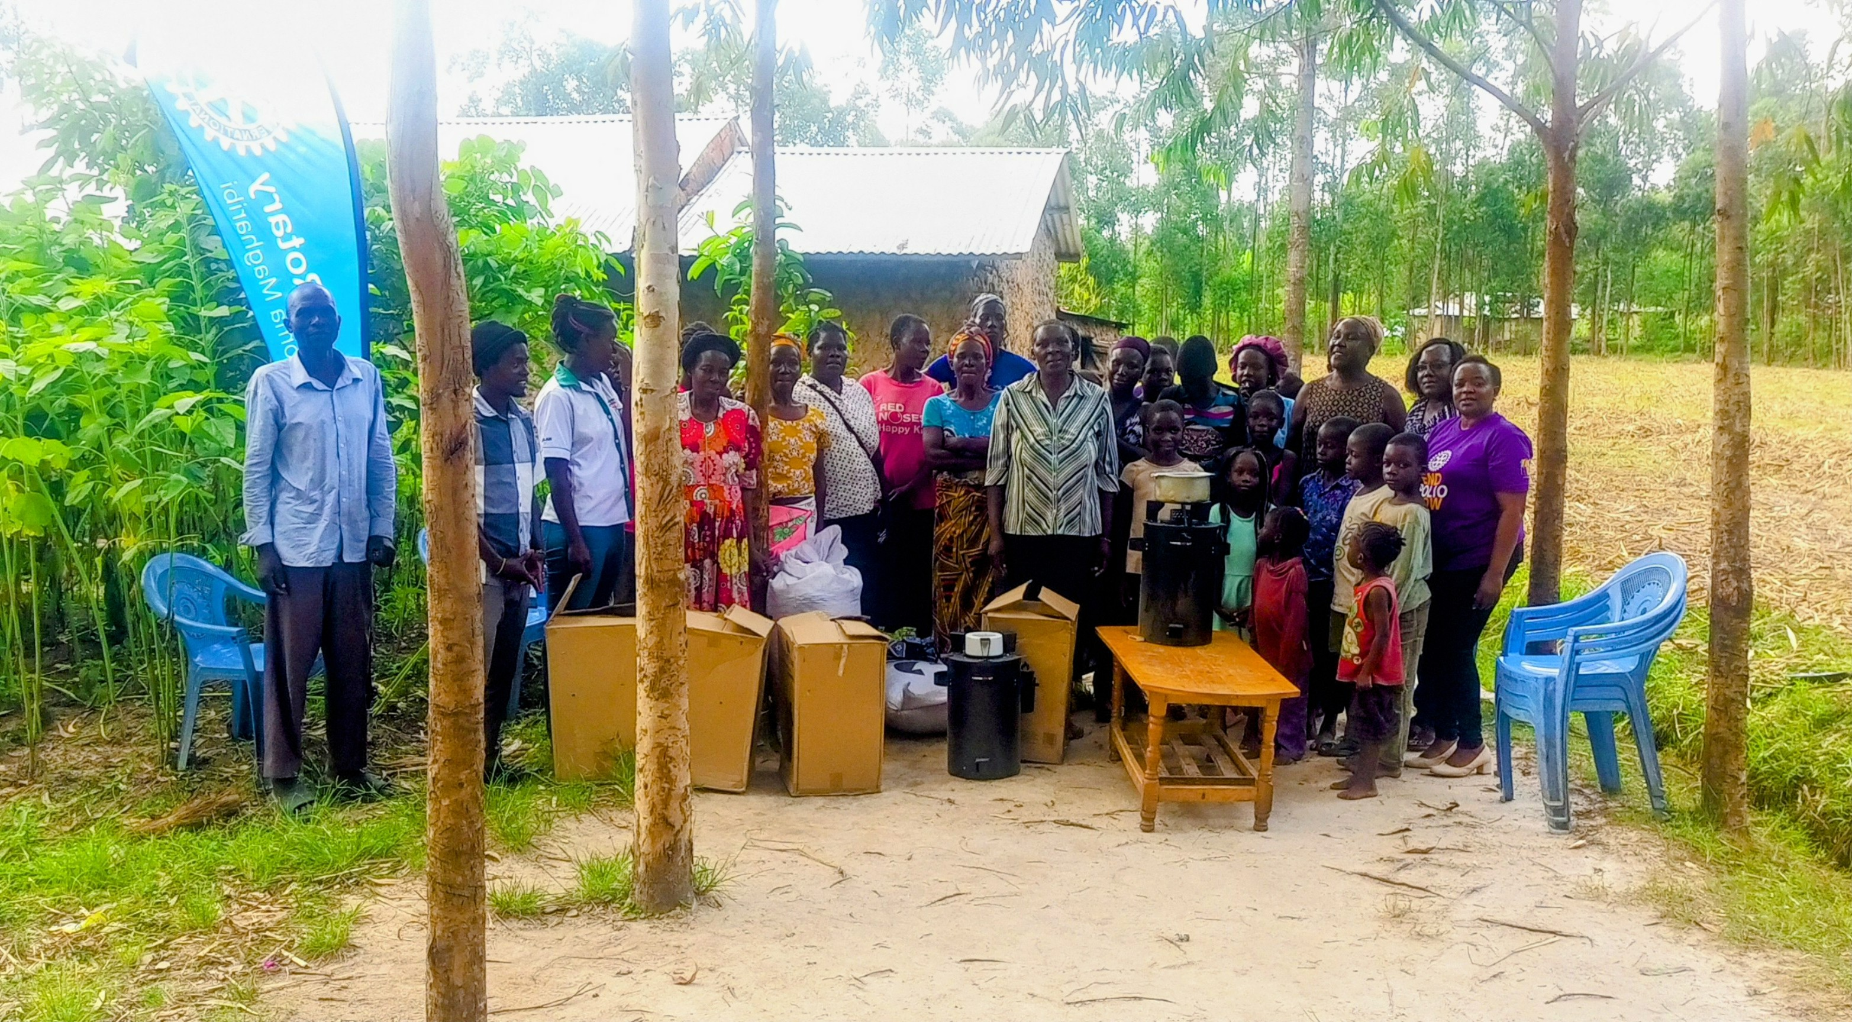
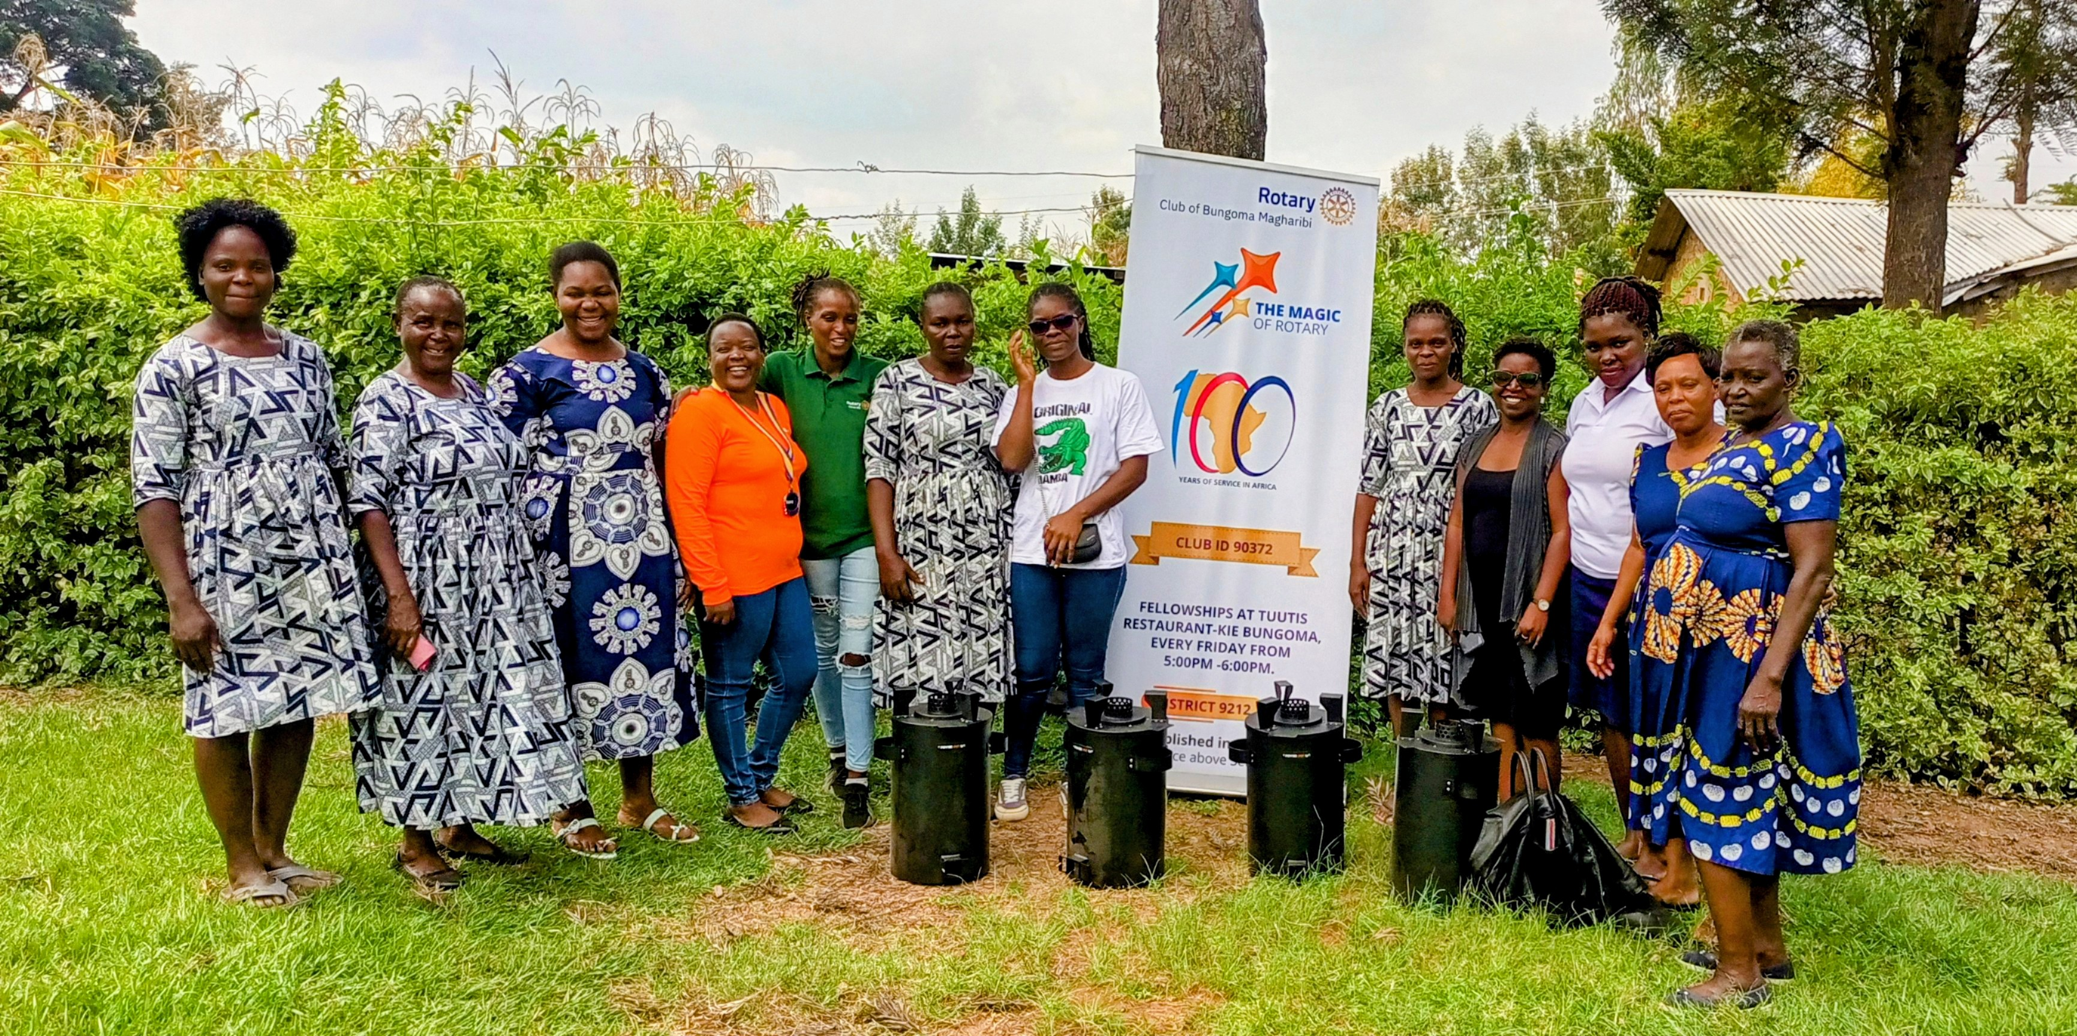
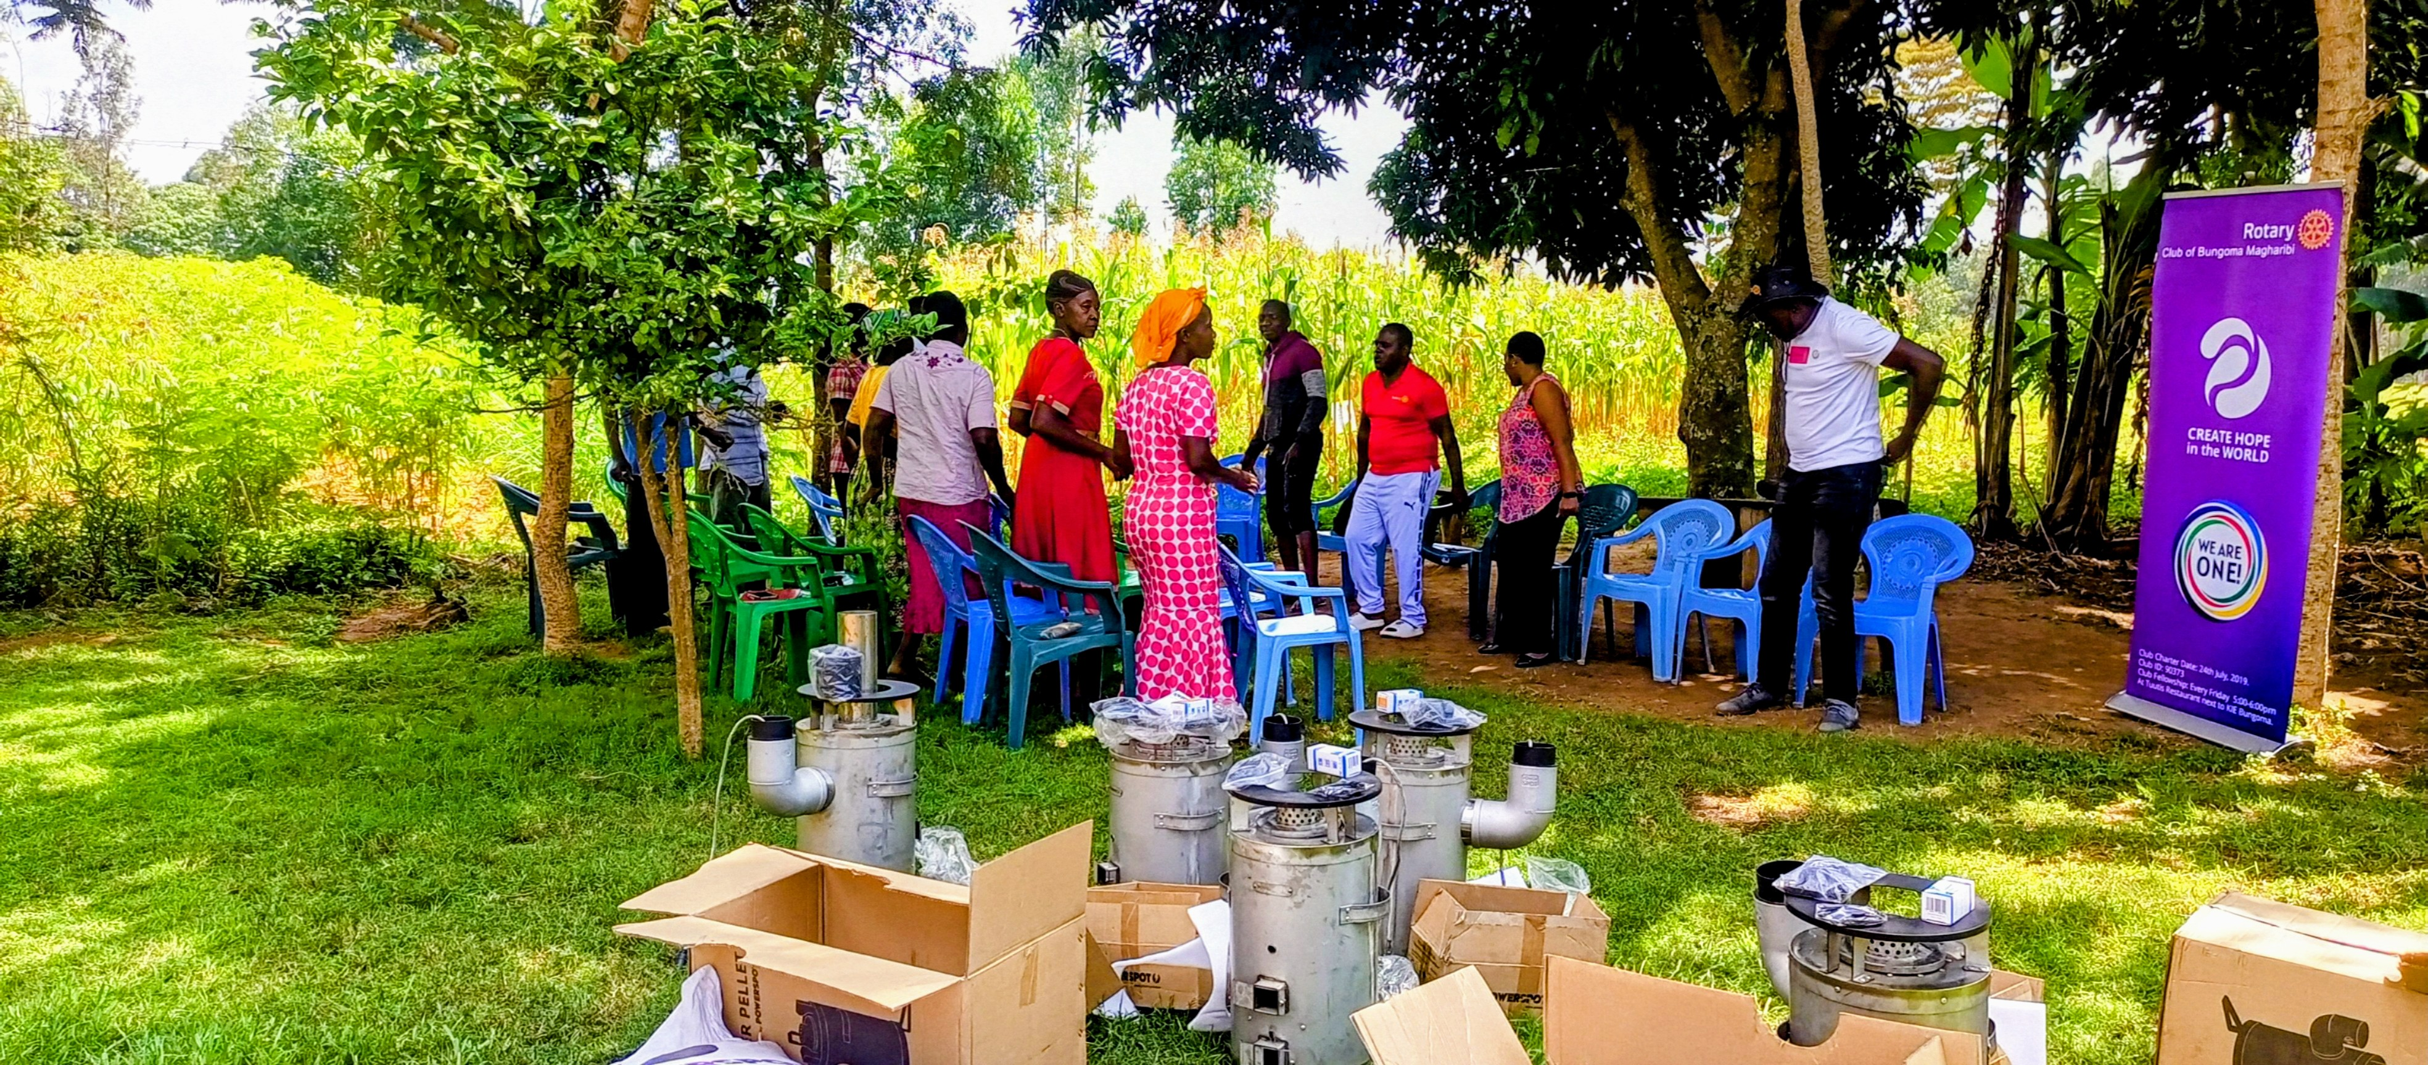
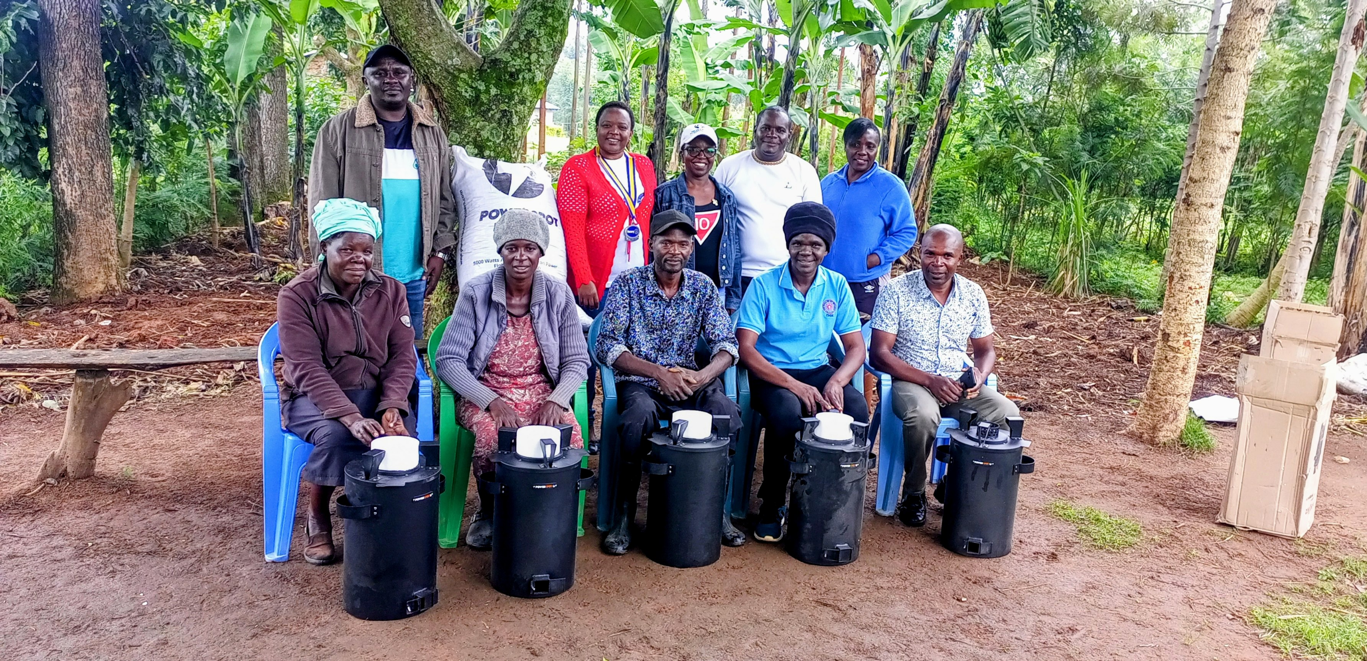
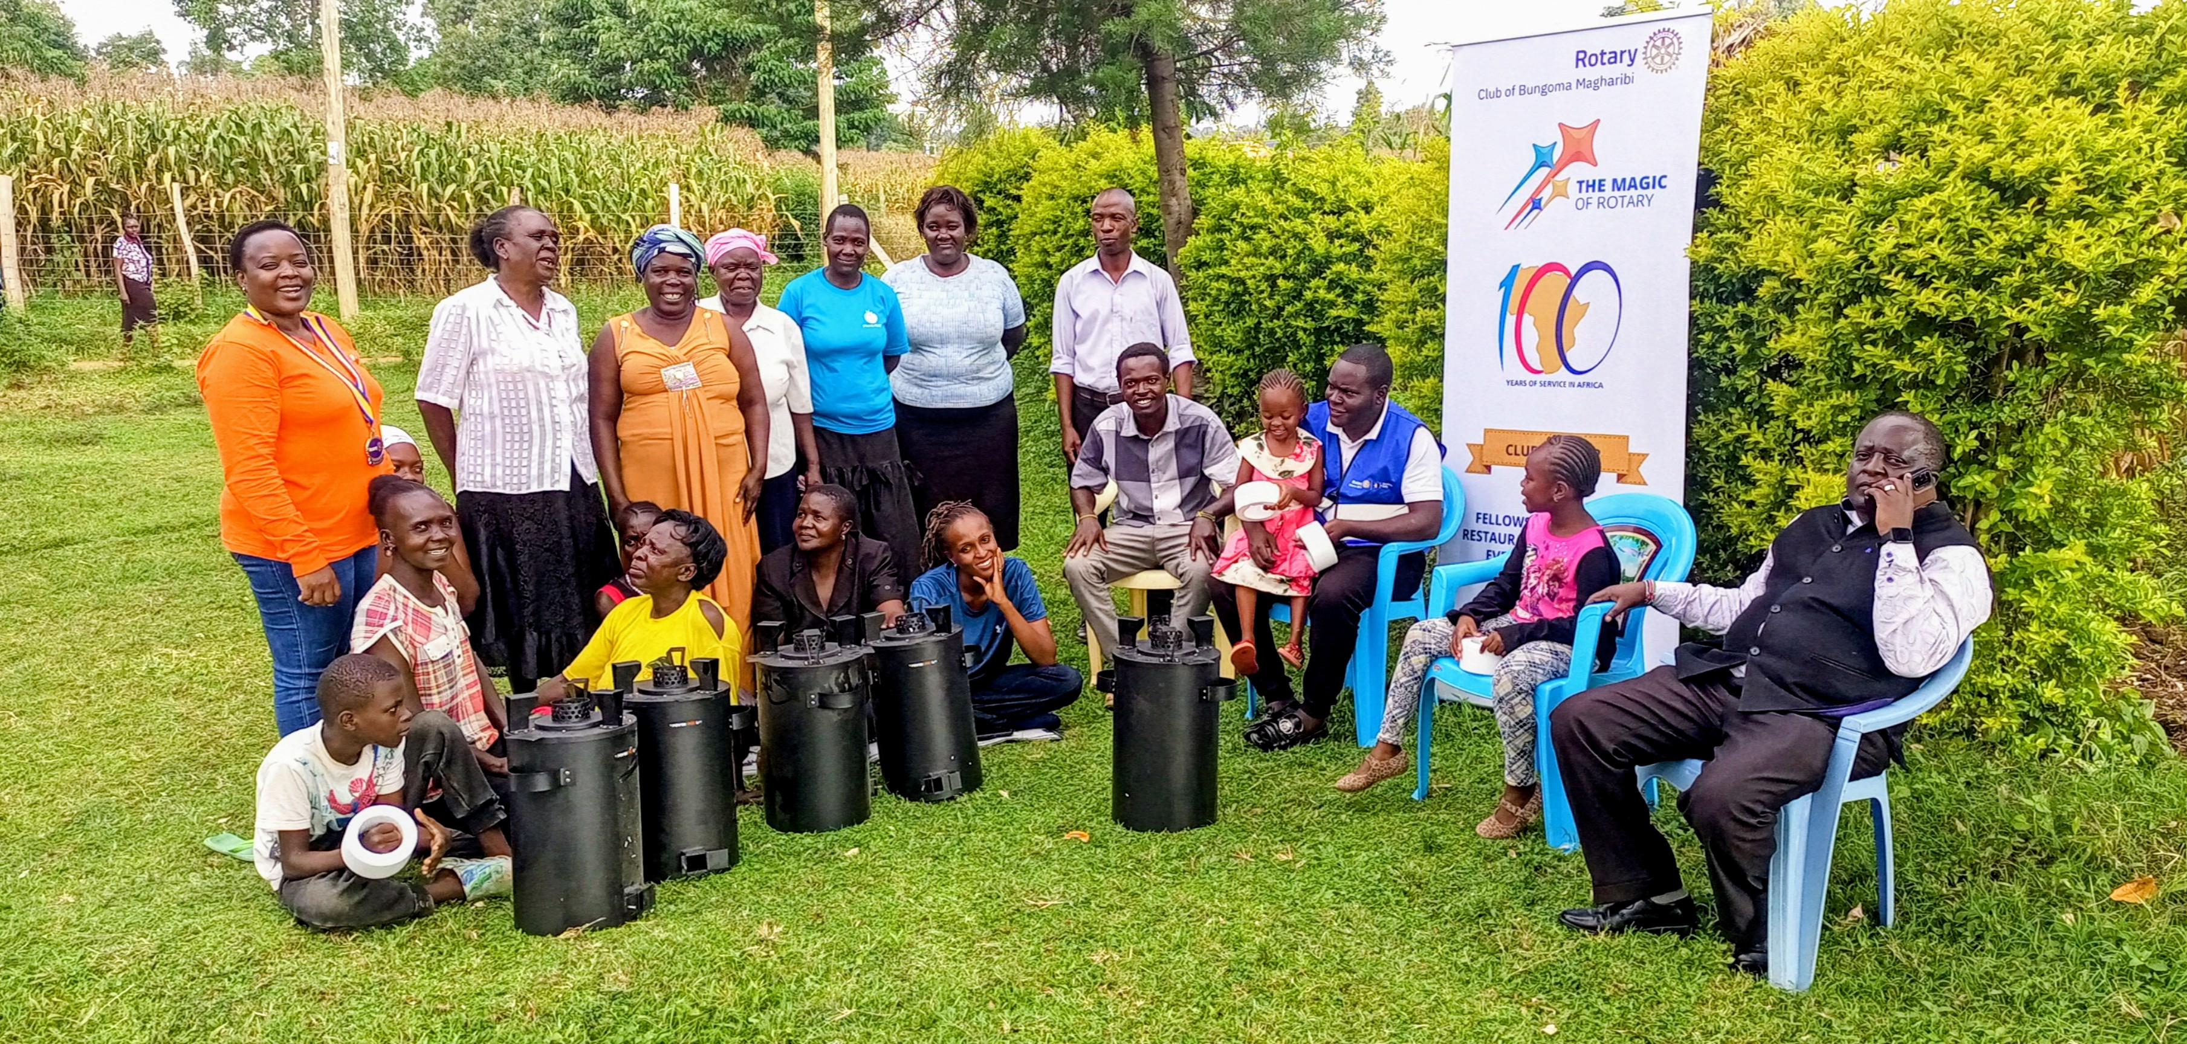
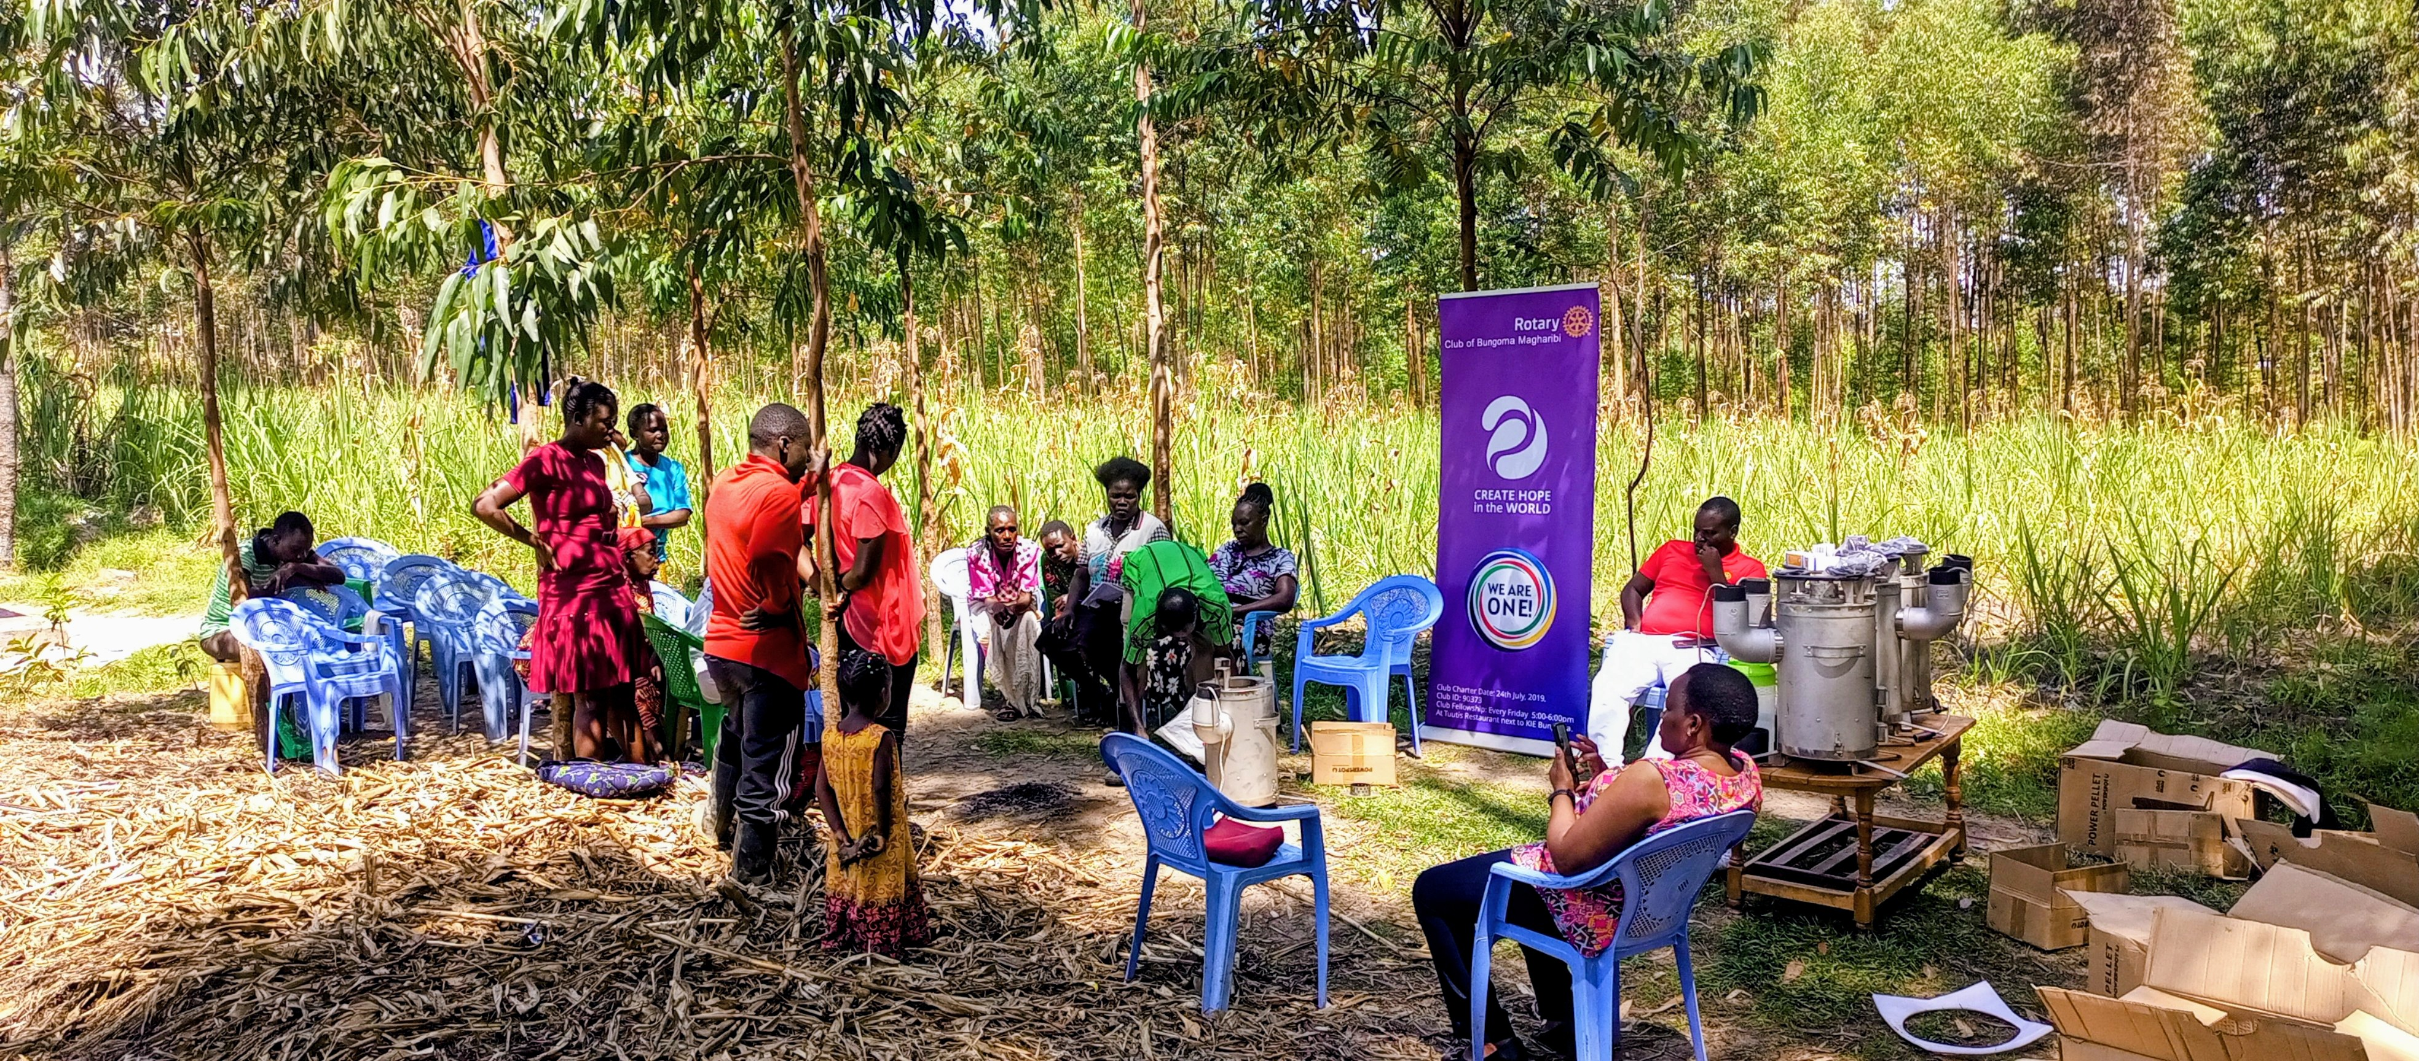
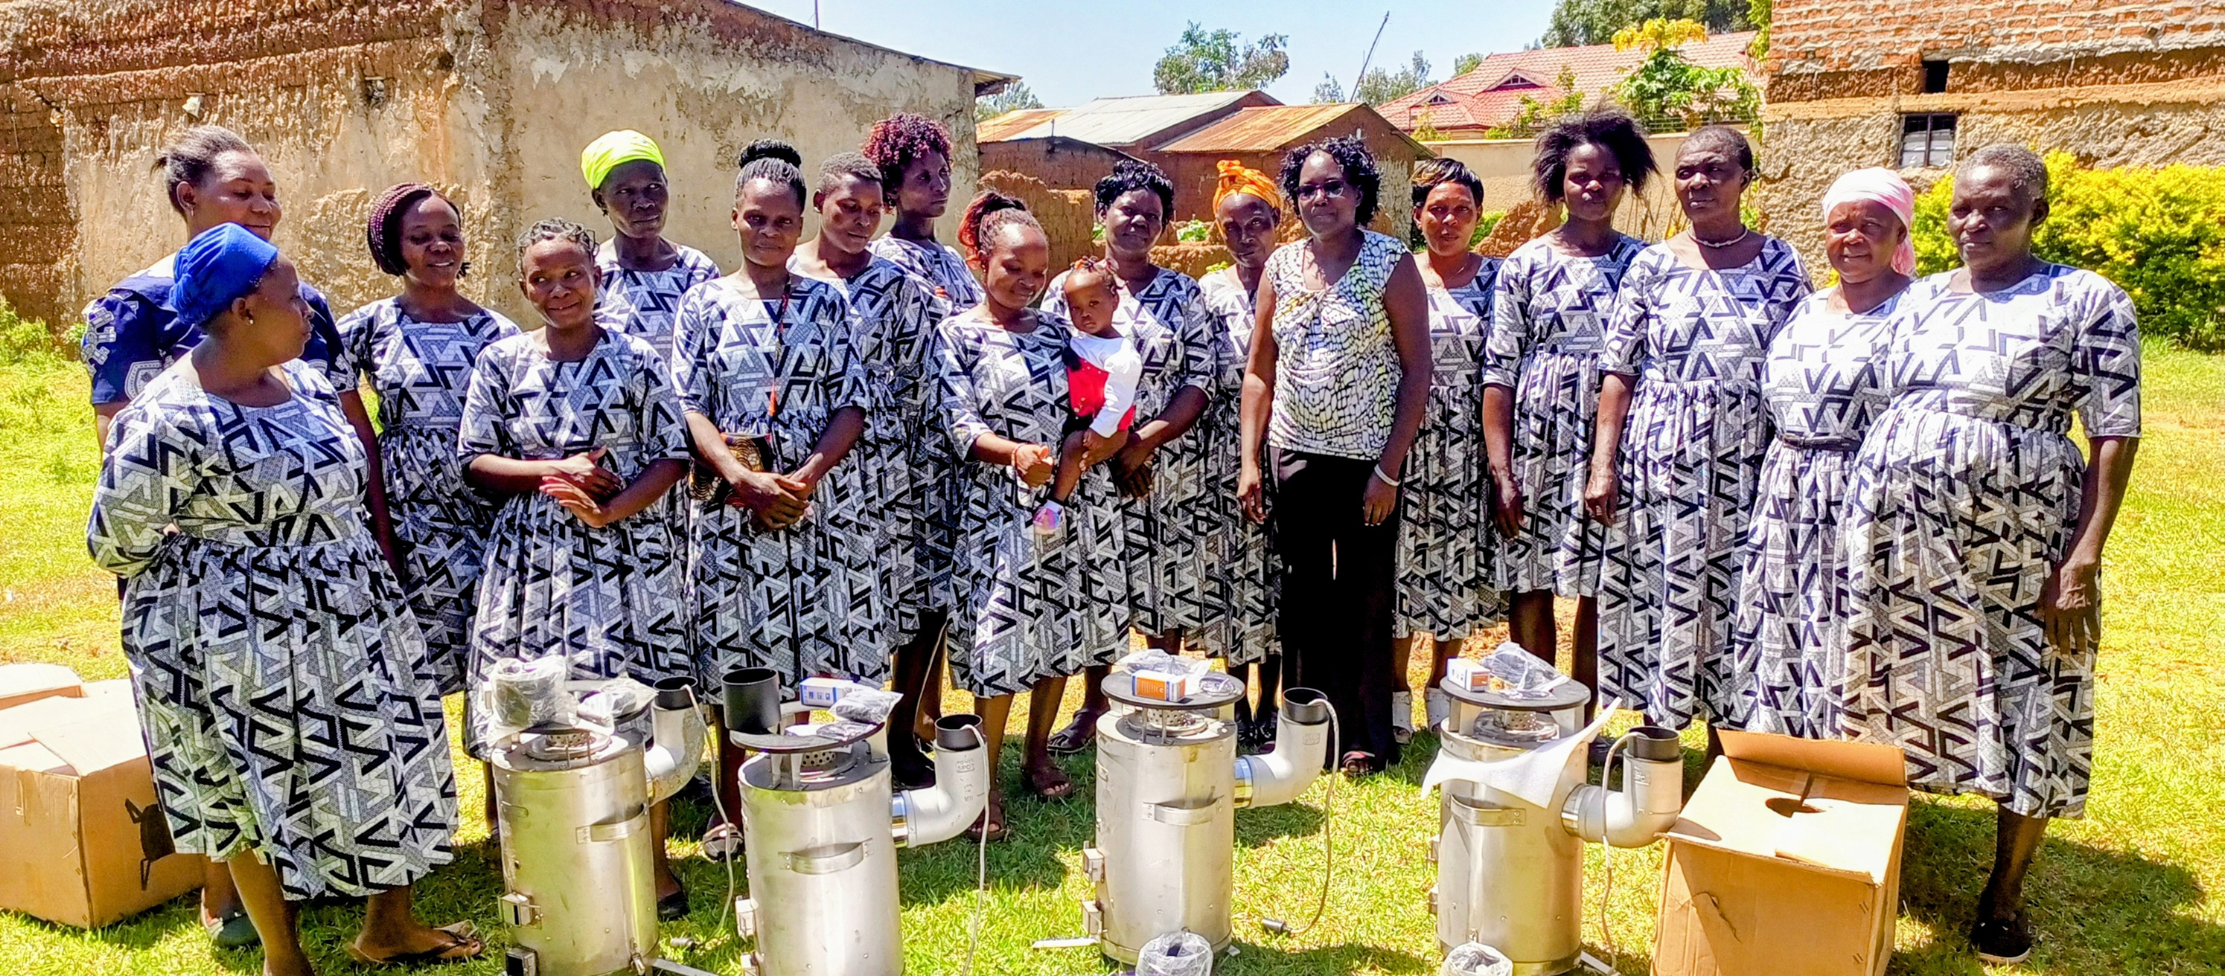
Our Partnership at a Glance
Sunset Rotary Club of Bloomington, Normal and
Rotary Club of Bungoma Magharibi.
Cookstove Donations Timeline:
December 2023: 25 TLUD cookstoves with thermo-electric generator.
July 2024: 25 TLUD cookstoves (5 with thermo-electric generator)
December 2024: 100 TLUD cookstoves
Current Total:150 TLUD clean cookstoves.
Beneficiaries:
Sikata Champions Women Self-help group.
Bidii Yefwe Women Self-help group
Joy Women Self-help group
Naitela Women Self-help group
Senna Women Self-help group
Each Women Self-help group has 30 cookstoves.

Slide 4
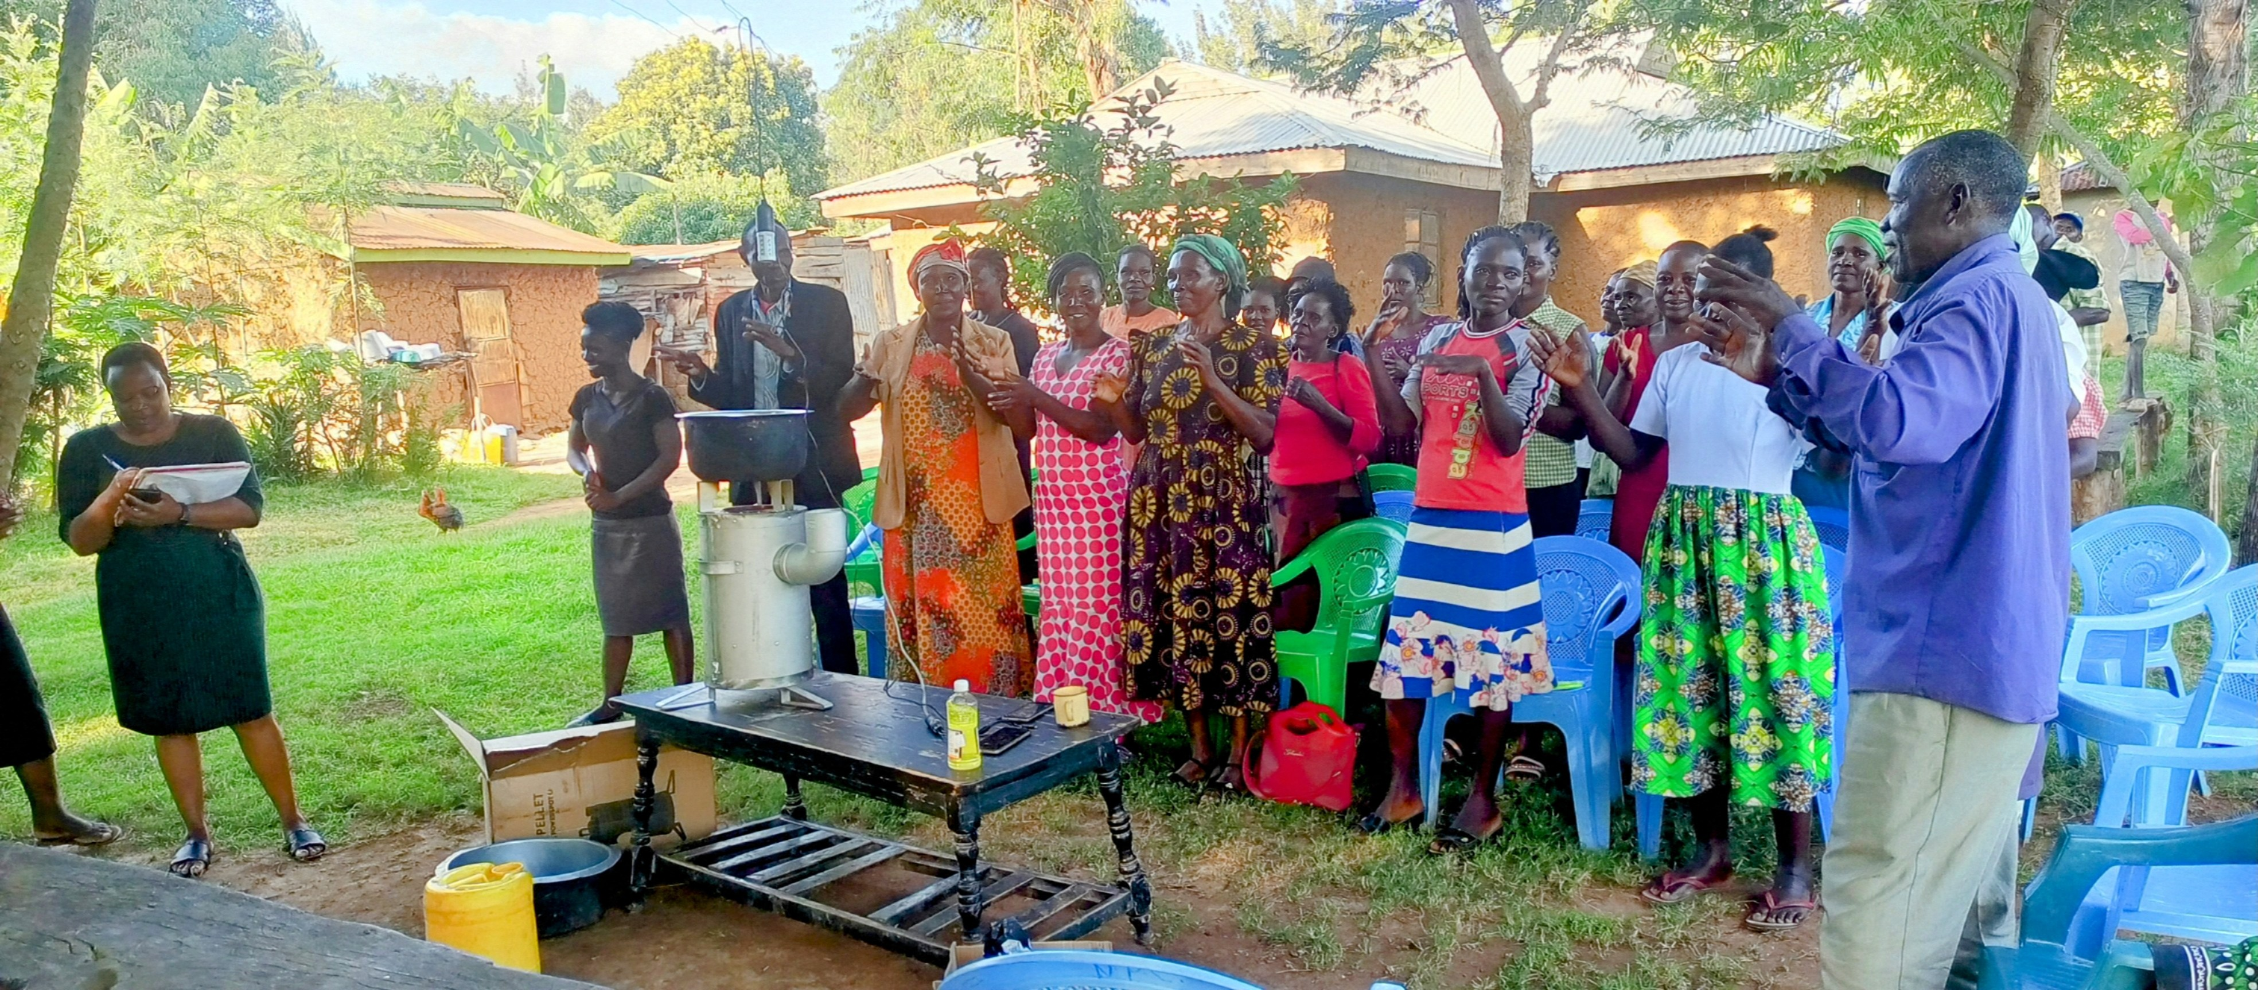
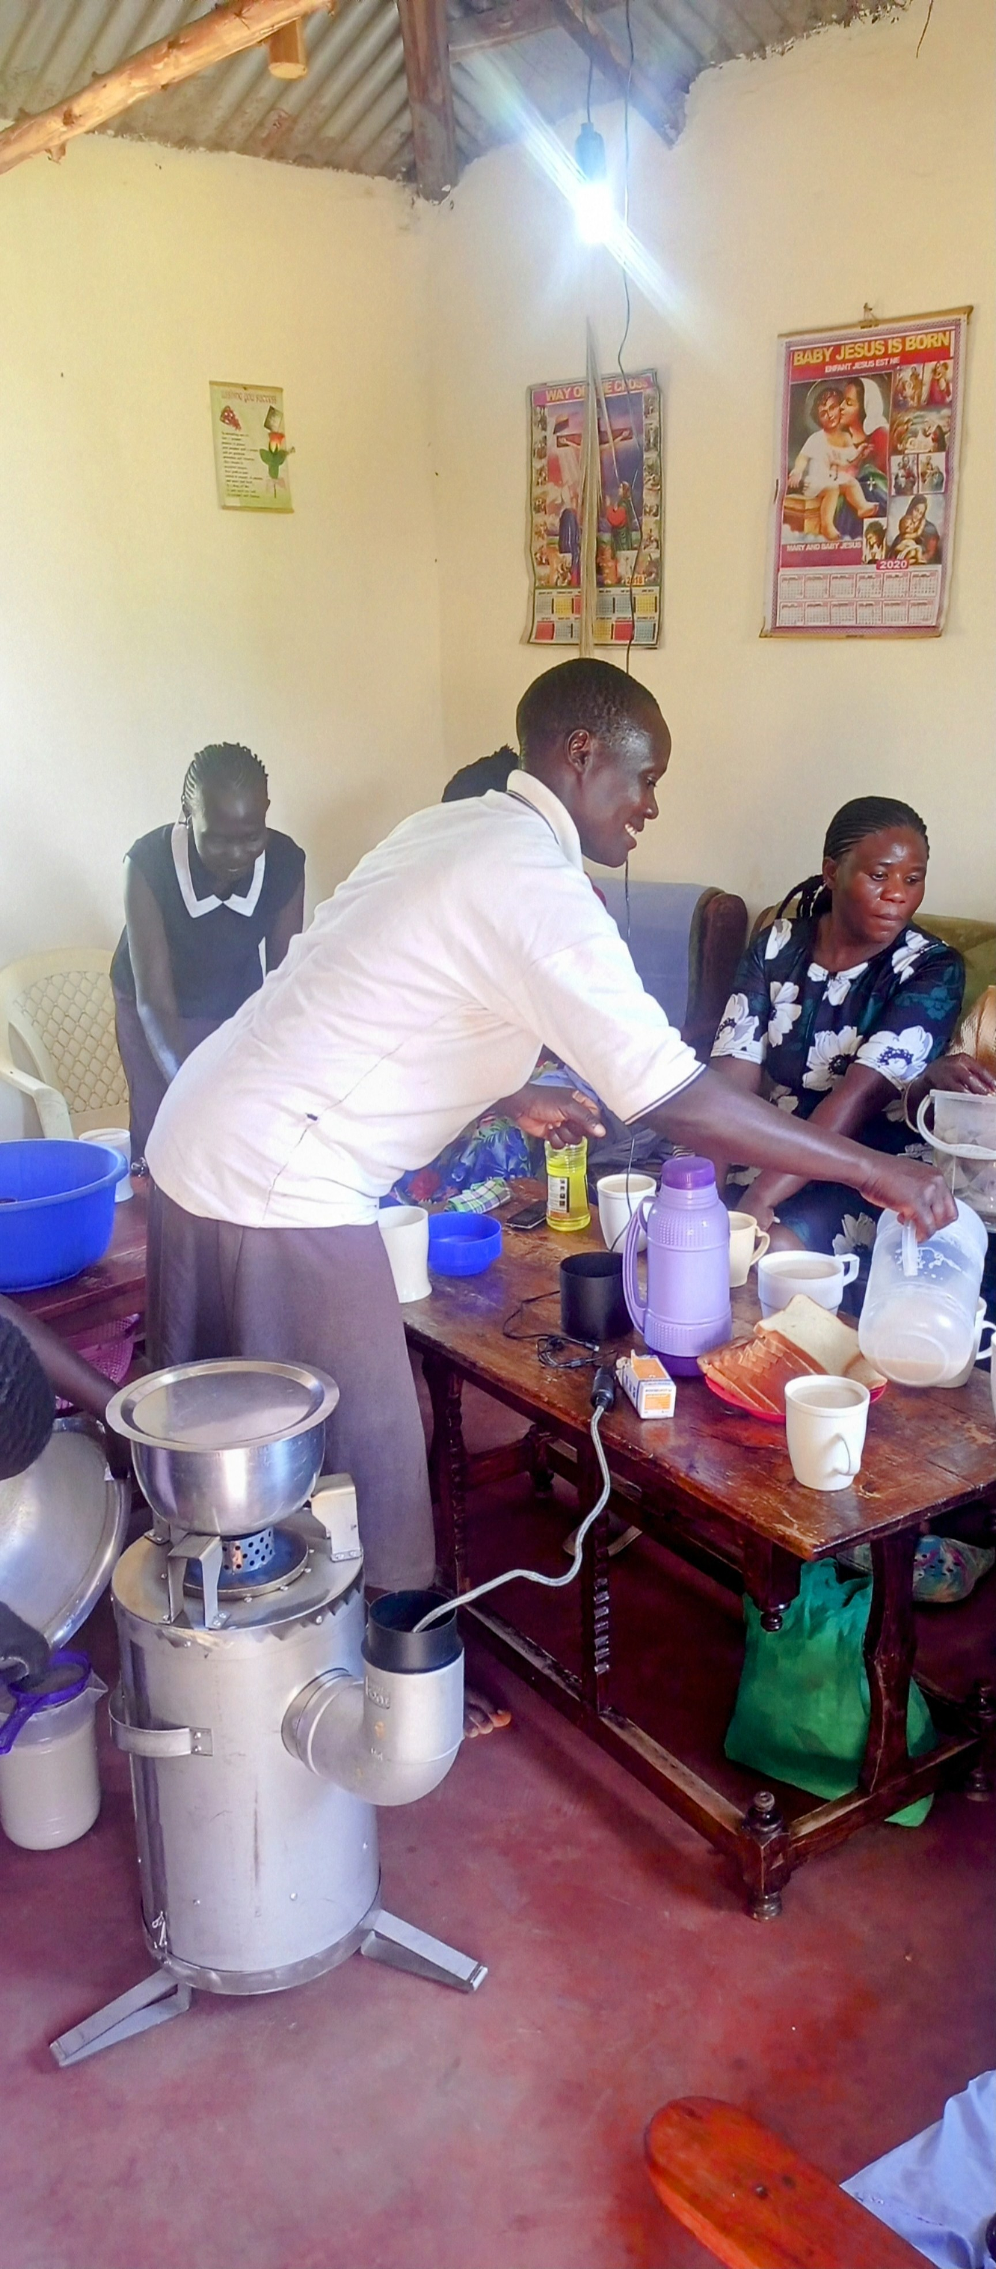
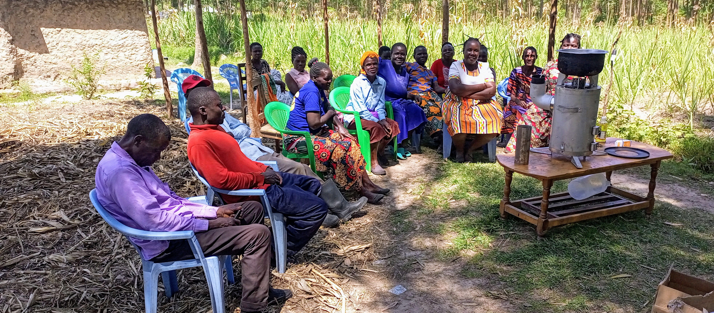
Features of TLUD Cookstoves
Clean & Efficient: Low emission gasification technology.
Fuel: Bagasse pellets (Abundant & sustainable)
Biochar production: For soil enrichment
Thermoelectric Generation (TEG) on 30 Cookstoves
Cogenerates DC power
Powers LED lighting bulbs.
Charges mobile phones
Fuel efficiency: Reduces firewood consumption by over 50%

Slide 5
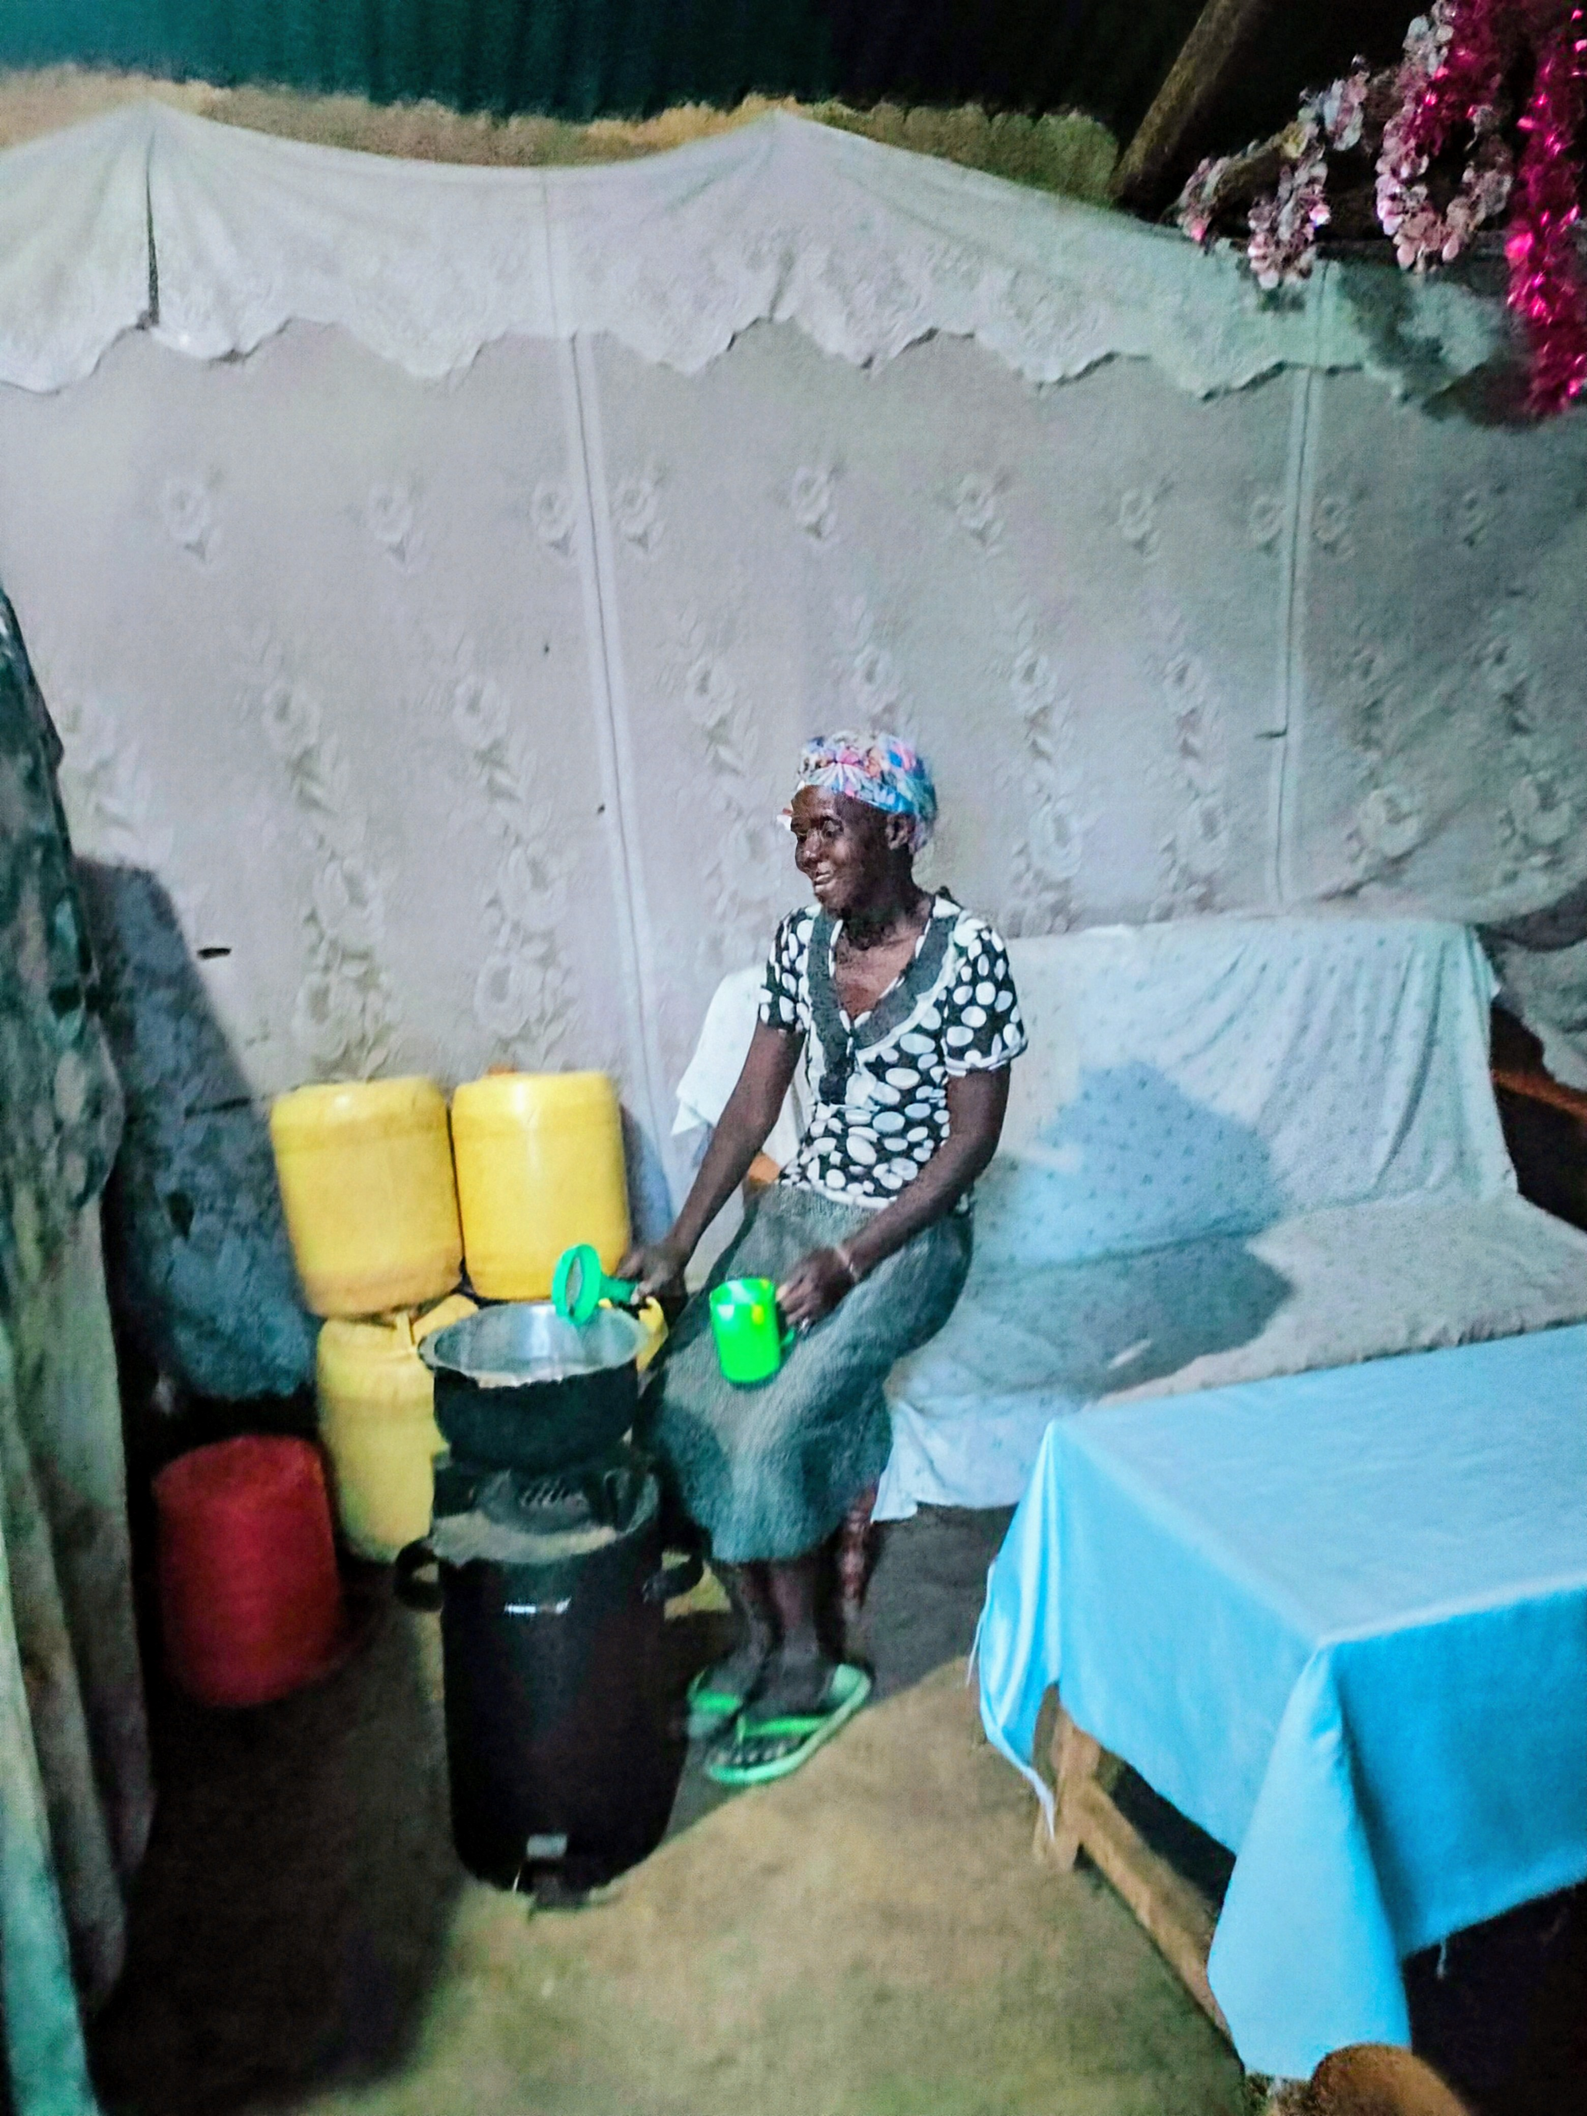
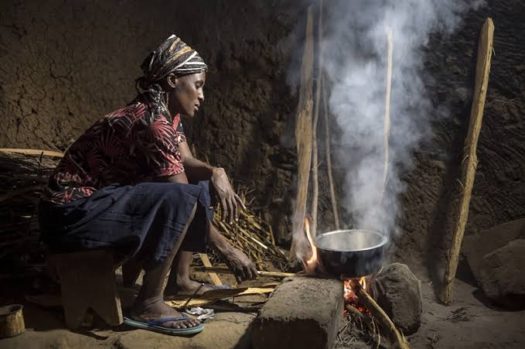
Health & Environmental Impact
Reduced indoor air pollution
Time saved
- Women reclaim 2-3 hours daily previously spent gathering firewood.
Environmental conservation
Reduction in firewood consumption.
Mitigates deforestation
Clean energy access.
TEG equipped stoves provide renewable lighting in households without electricity.
Replaces harmful tin lamps and lanterns

Slide 6
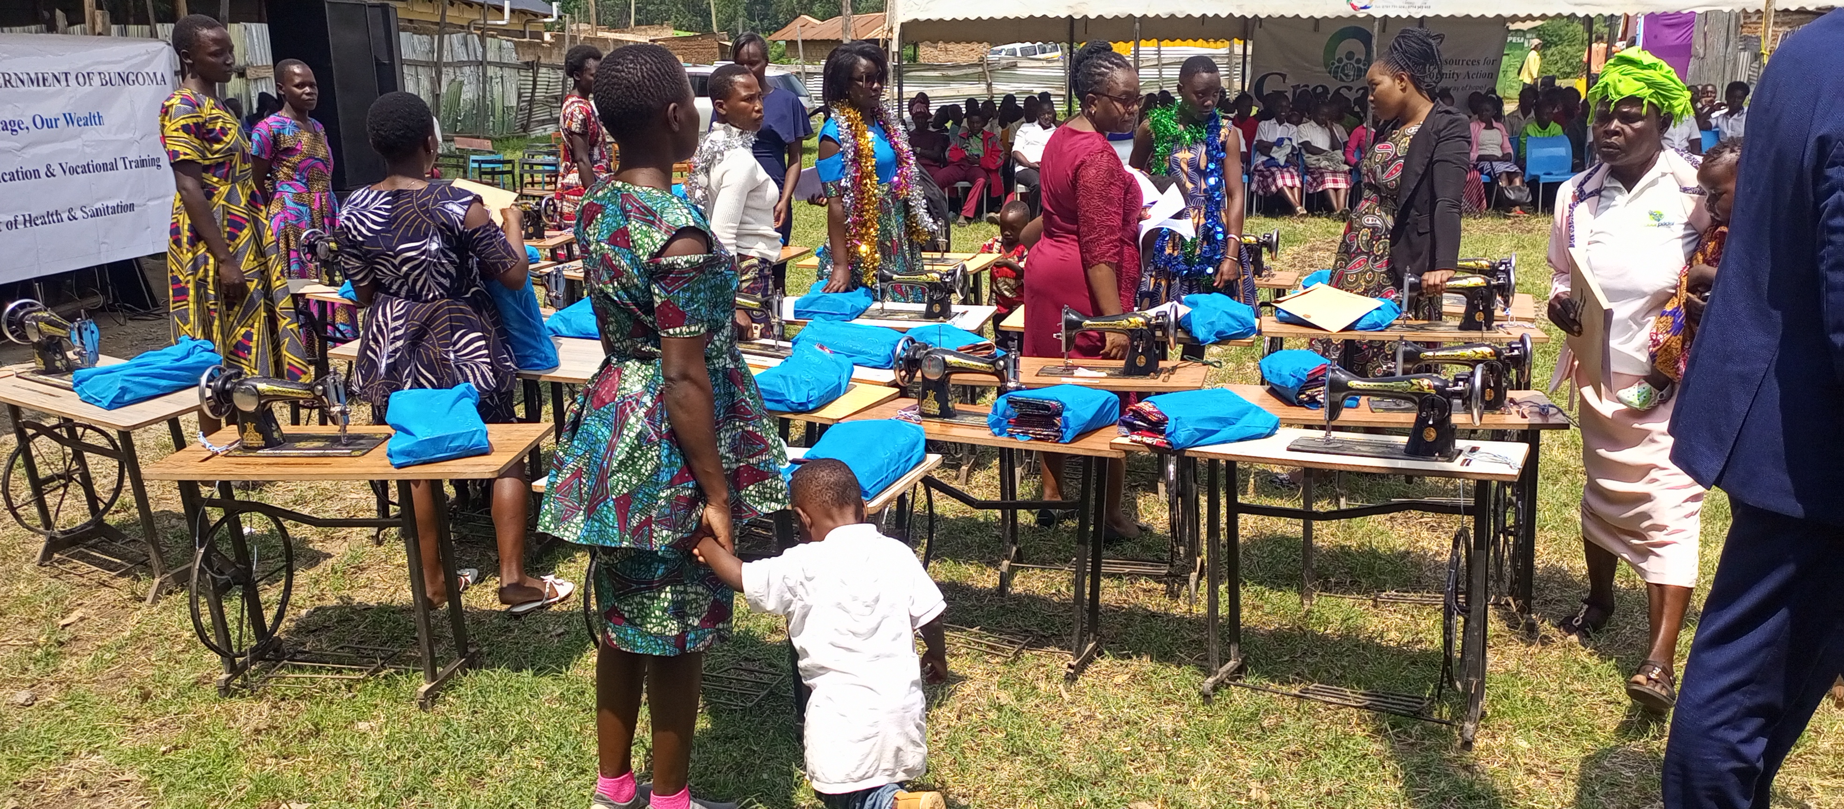
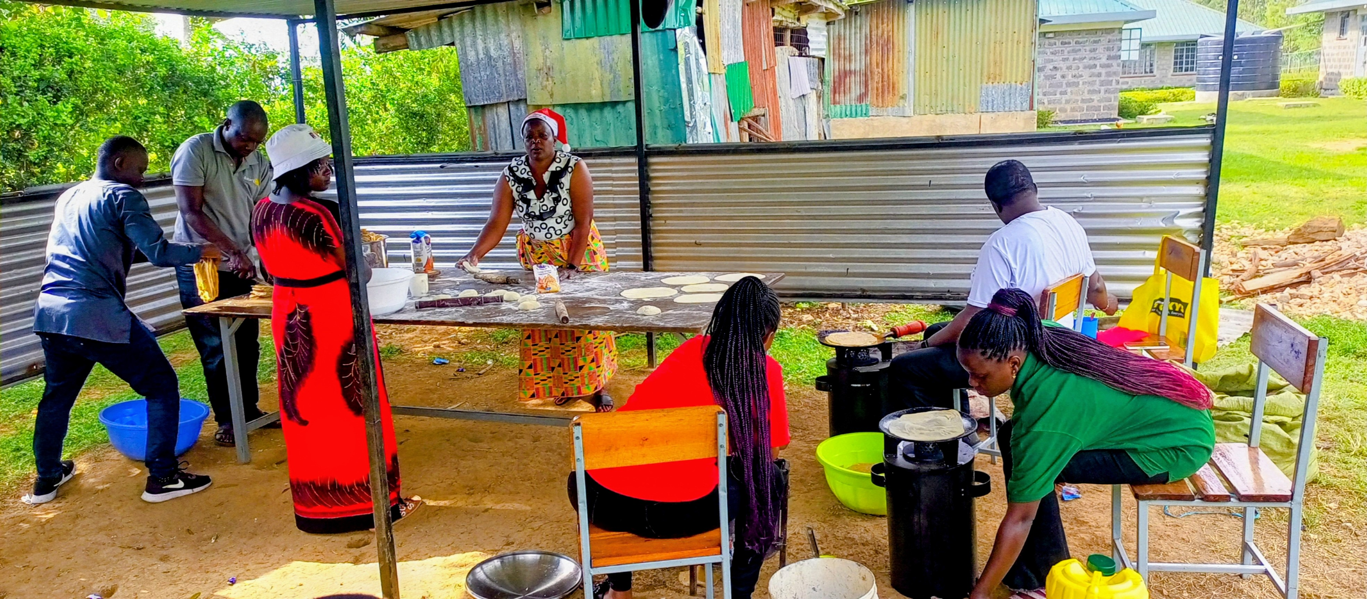
Economic Empowerment
Reduced energy costs.
Less money spent on cooking fuel
Time reallocated.
Women engage in income generating activities like farming and small businesses.
Community saving groups.
Increased savings from energy efficiency reinvested into groups merry-go-rounds.
Entrepreneurial ventures.
Joy WSG started cooking services for ceremonies within their locality using their clean cookstoves

Slide 7
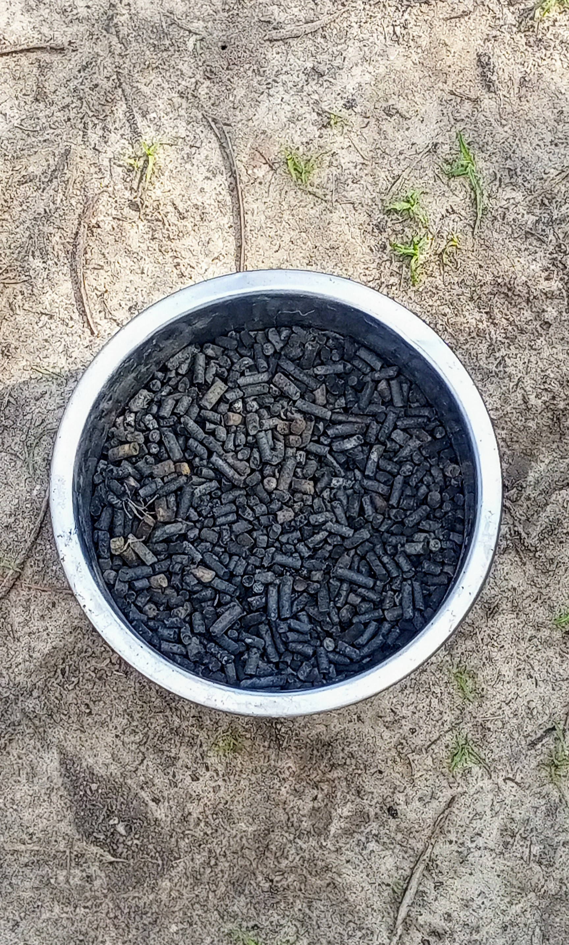
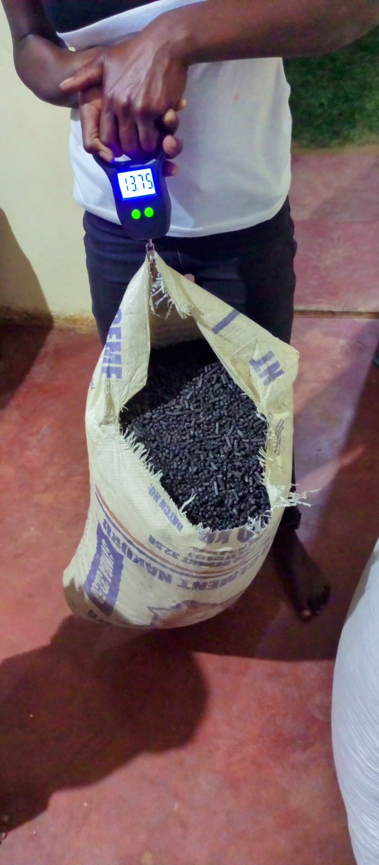
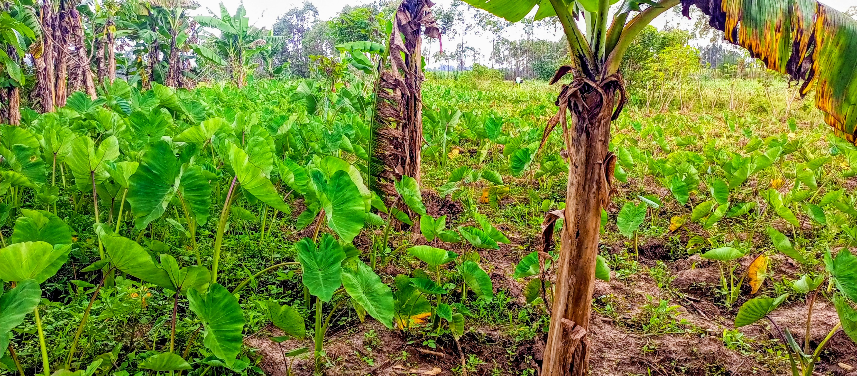
Biochar & Agriculture impact
Biochar from bagasse pellets
Enriches soil in kitchen gardens
Improves water retention and soil fertility.
Reduces need for synthetic fertilizers.
Food security boost.
Better crop yields reported.
Improved nutrition for households
Circular economy.
Waste to resource conversion empowers women as stewards of their environment.

Slide 8
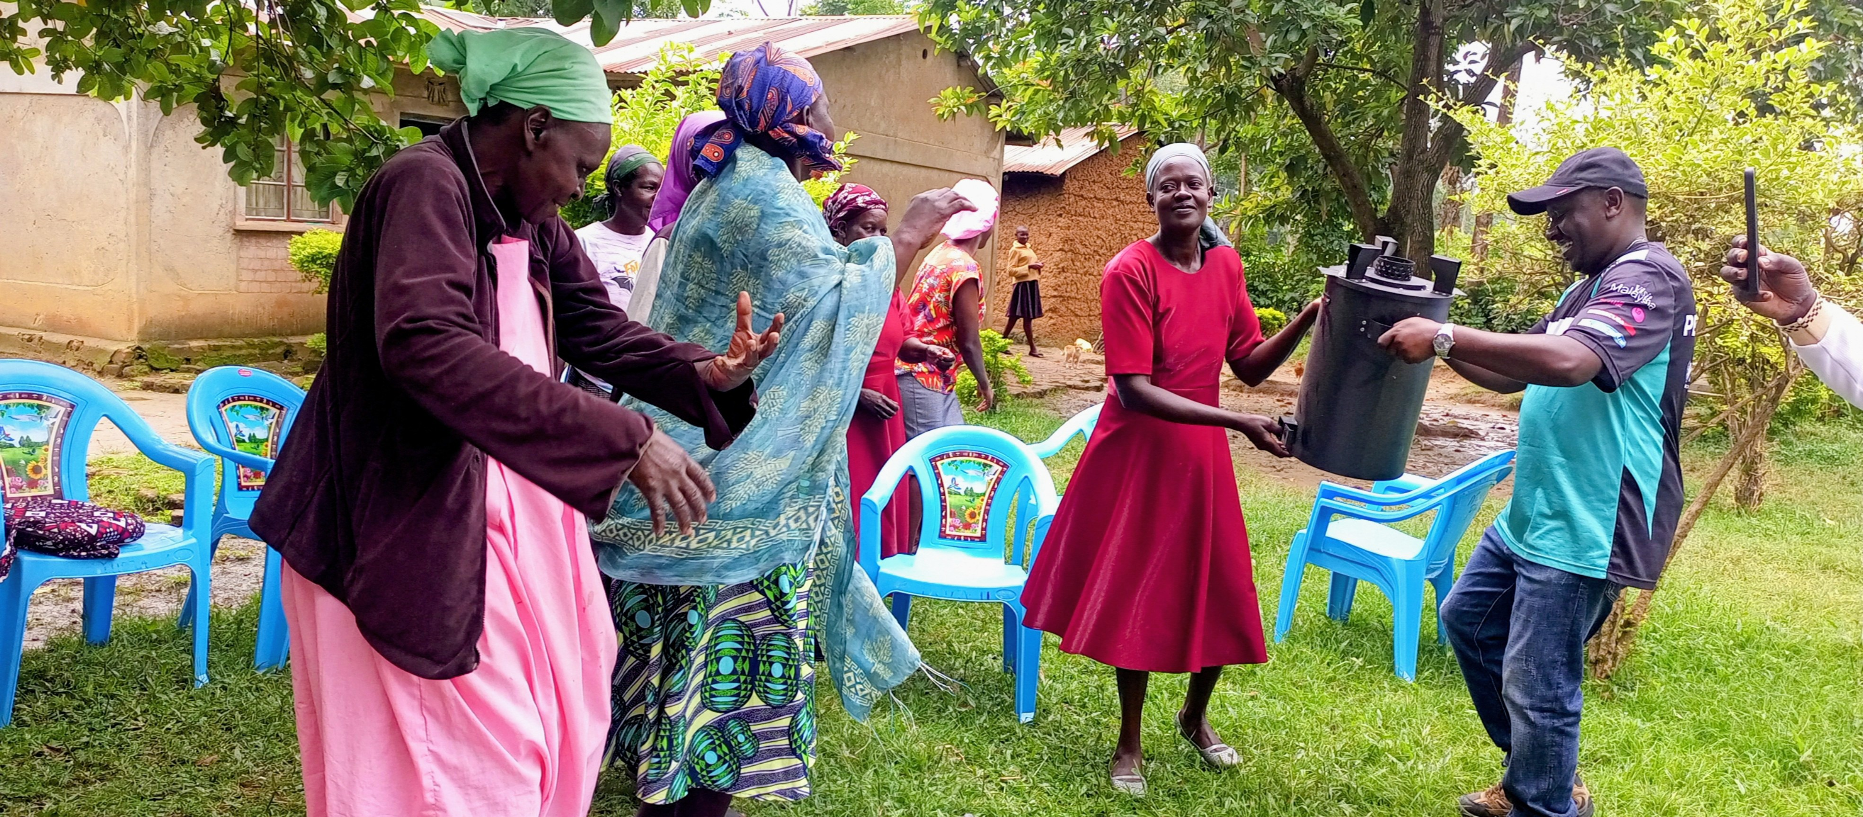
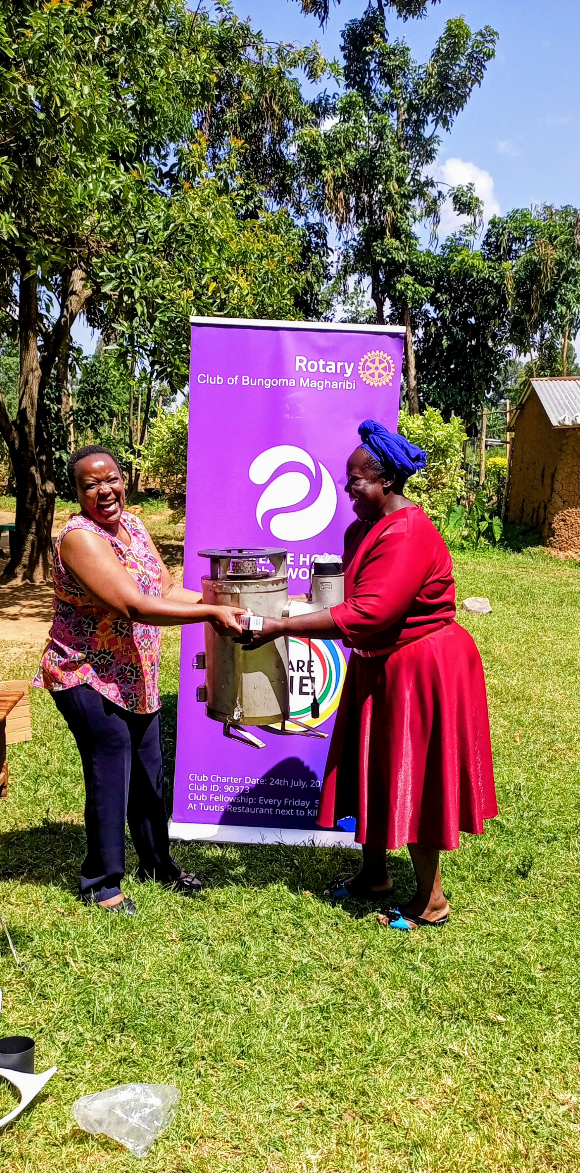
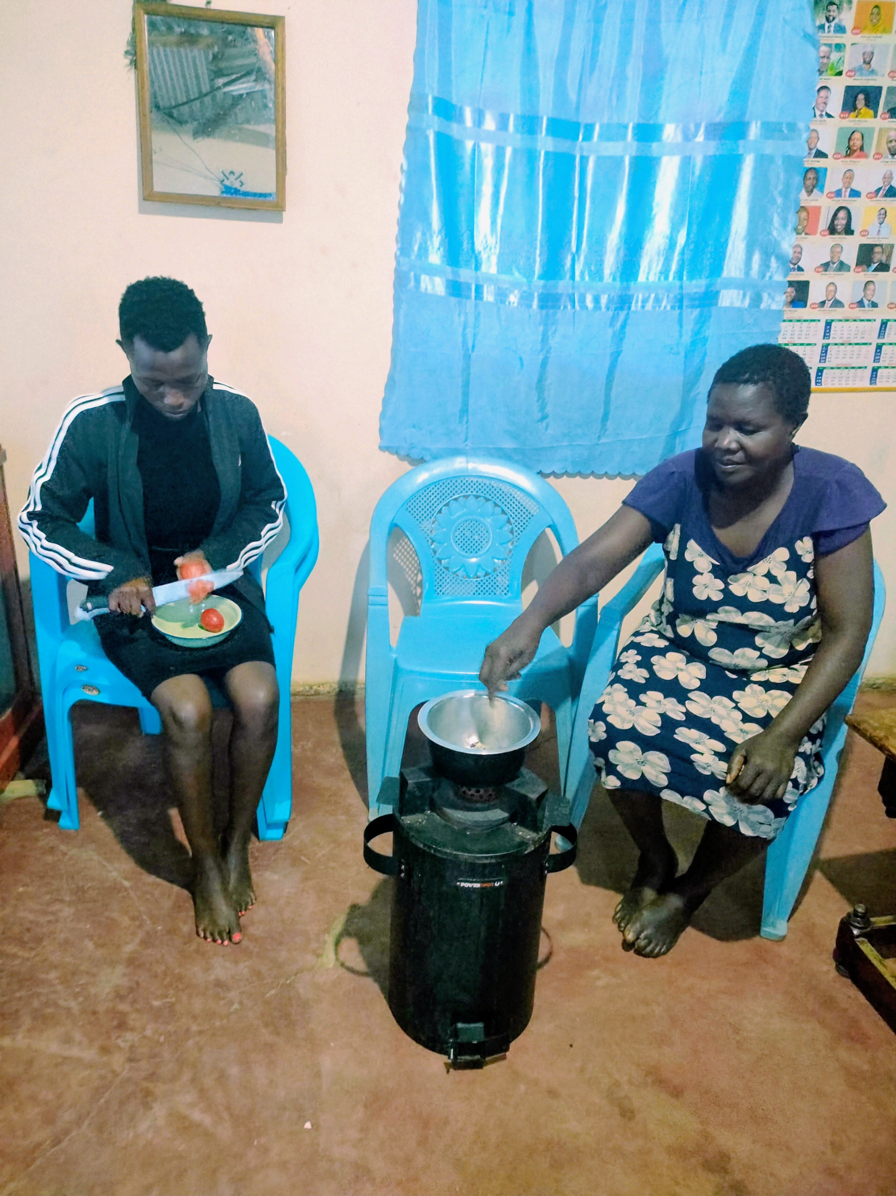
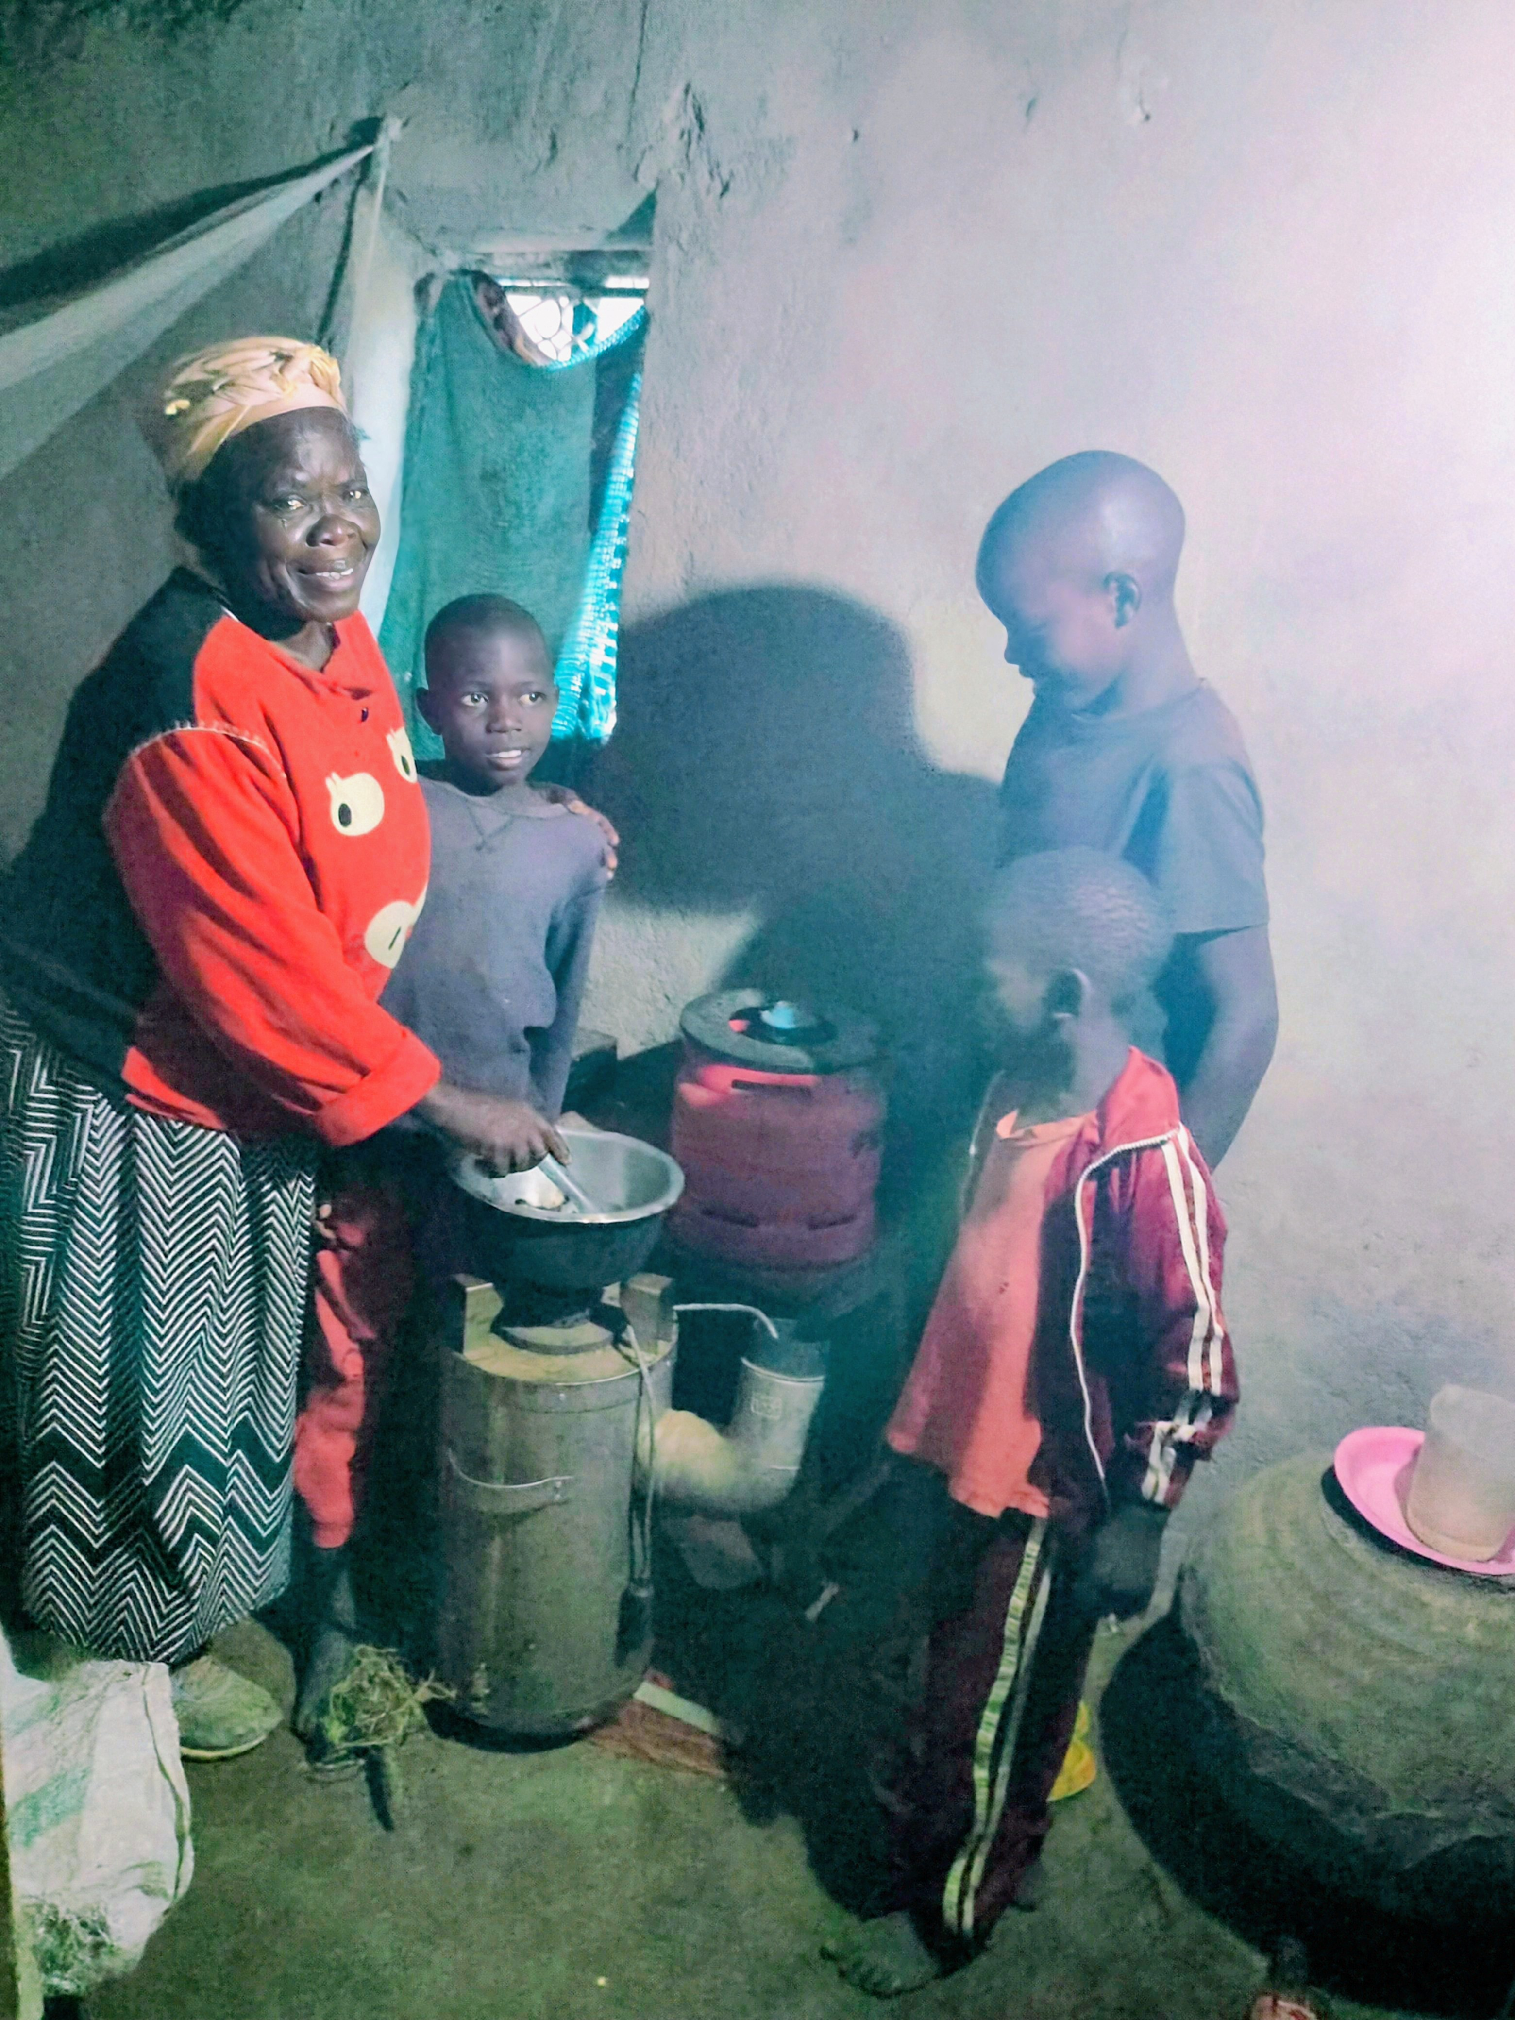
Testimonials from Beneficiaries
Lydia Barasa – Senna Group
“I used to spend hours finding firewood. Now, I help out at a green grocery with the extra time. I even save money charging my cell phone at home when cooking”.
Imelda Wanjala – Naitela Group
“I can now cook faster with pellets and no smoke!”
Janet Mangara – Joy Group
“My children can do homework at night using the light from the TEG stove.
Jentrix Majuma – Sikata Champions Chair.
“ These cookstoves don’t just cook food, they cook a better future for our families”.

Slide 9
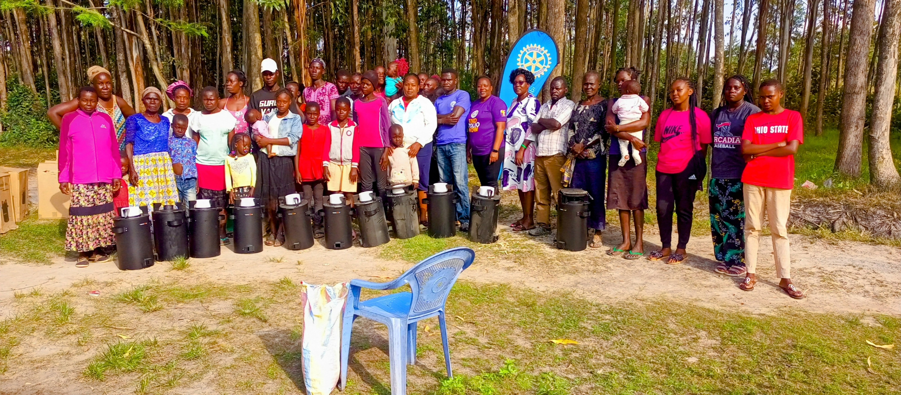
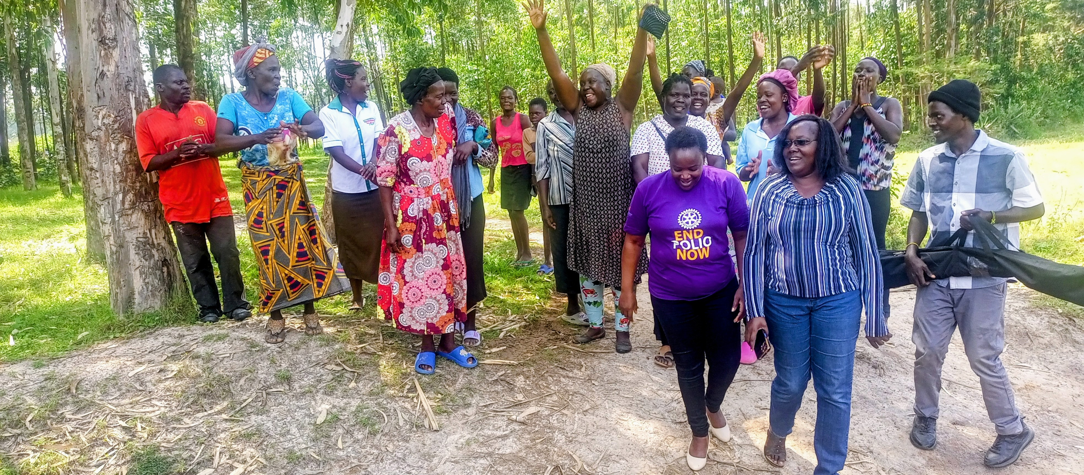
What’s Next?
April 2025:
Planned donation of 100 more TLUD stoves to women’s self-help groups.
Expanding the model to neighboring villages
Goal:
500 cookstoves by this Rotary year (2024 – 2025)!

Slide 10
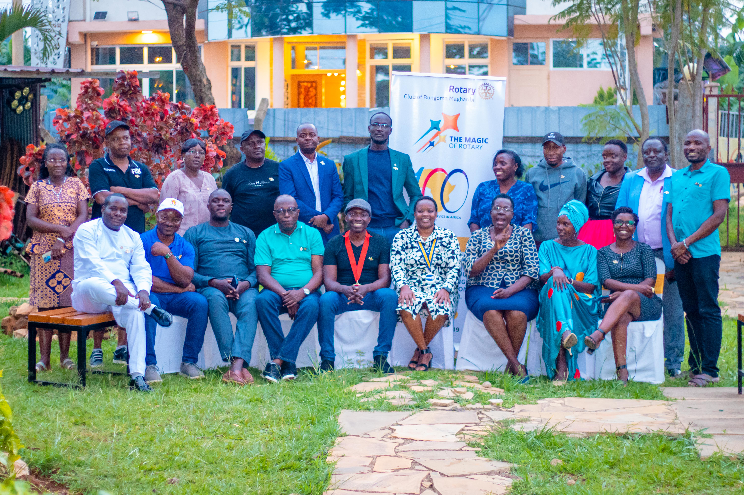
Warm Greetings & Acknowledgment
Impact made possible through the generosity of the Sunset Rotary Club of Bloomington-Normal
Thank you, Rotary Club of Bloomington-Normal Sunset, for your overwhelming support.
Bungoma County, Kenya, faces significant energy poverty challenges.
Our partnership with you aims to address this through sustainable energy solutions.
You are lighting homes, healing the earth, and empowering women
Together, we are sparking change, one household at a time.
Presented by:
Rotary Club of Bungoma Magharibi
March 2025

Slide 11
